Slide 1
Pediatric Collaborative Care Behavioral Health Conference 2024-2025
Text: 608-260-7097
Code: FADYER
Please text to record your attendance and claim credit. Even if you do not need the credit, please text in to record your attendance!
Need support? Email Kate Dougherty at catherine.dougherty@wisc.edu
Text: 608-260-7097
Code: FADYER

Slide 2
Assessment and Management of Pediatric Self-Harm and Suicidal Ideation in Primary Care
Hannah Koerten, PhD
March 18, 2025
Pediatric Collaborative Care Behavioral Health Conference Session #12

Slide 3
Conflict of Interest
The planner and speaker of this CE activity has no relevant financial relationships with ineligible companies to disclose.
The speaker does not intend to discuss any unlabeled or unapproved use of drugs or devices.
Text: 608-260-7097
Code: FADYER

Slide 4
Please take a moment at the end of the session to complete your evaluation.
Thank you!
Text: 608-260-7097
Code: FADYER

Slide 5
Learning Objectives
After completion of this session, participants will be able to:
Outline a thorough assessment of self-harm behaviors and suicidal ideation in pediatric populations.
Create a safety plan, including environmental safety (e.g., parental supervision or check-ins, removing dangerous items, school safety).
Explain effective coping strategies (e.g., TIPP, grounding exercises) as replacement behaviors for self-harm and/or suicide behaviors.
Assess level of follow-up care needed based on assessment of risk (e.g., ER evaluation, follow-up visits with therapists/psychiatrists or primary care)
Discuss efficient and thorough documentation of assessment, safety plan, and follow-up care.

Slide 6
Outline
Rates of Suicidal Ideation (SI) and Self-Harm in Teens
SI and Self-Harm Assessment
Safety Planning
Follow-Up Care
Coping Strategies
Throughout the presentation, I have included my personal dot phrases and some helpful resources (e.g., handouts, websites, videos).
Notes:
These are my own dot phrases (not official UW Health dot phrases) that you are welcome to make a copy of and edit to fit your needs for your own practice, if you do not already have your own templates

Slide 7
Rates of Suicidal Ideation and Self-Harm
Approximately 19% of adolescents seriously consider attempting suicide (Ivey-Stephenson et al., 2020)
SI rates are higher for females (24%) than males (13%), and higher for lesbian, gay, or bisexual teens (47%) than for heterosexual teens (15%). Transgender and non-binary teens have the highest rates of SI (53%).
Approximately 9% of adolescents report one or more suicide attempt
Attempt rates are higher for females (11%) than males (7%), and for Black teens (12%) than Hispanic (9%) or White (8%) teens. As with SI, transgender and non-binary teens have the highest rates of SA (26%).
Approximately 16% of adolescents engage in self harm (Farkas et al., 2024)
Self-harm rates are higher for females (19%) than males (13%)
Note: Data on transgender/non-binary youth come from a corrected report (Suarez et al., 2023)
Notes:
Ivey-Stephenson: CDC 2020

Slide 8
UW Health Initial Assessment
Teen forms (ages 12-17) at UW preventative care visits include the following question: Have you ever seriously thought about killing yourself, tried to kill yourself, or have purposely cut, burned, or otherwise hurt yourself?
A “yes” to this question can mean many different things!
Passive SI: “Sometimes I wish I was dead.”
Active SI with no plan or intent: “I want to kill myself, but I know I won’t actually do it.”
Active SI with plan and intent: “I am going to kill myself by taking my medications.”
Self-Harm (e.g., cutting on arms/thighs with sharp objects without intent to die)
Teens may also deny self-harm on the form, but you see signs of self-harm during the physical exam

Slide 9
Case Example
You are seeing Sam, a 16-year-old Hispanic non-binary teen, for a yearly well-check. They have a history of mild depression and anxiety. Sam has never met with a therapist or psychiatrist.
Sam endorsed thoughts of self-harm or SI on the preventative form.
We will walk through each of the following for Sam’s visit:
Assessment
Safety Planning
Follow-Up Care
Coping Strategies

Slide 10
Assessment – Suicidal Ideation
*Passive Thoughts
Frequency
Timing
*Active Thoughts
Have you wished you were dead or wished you could go to sleep and not wake up?
Have you had thoughts of killing yourself?
How often do you have these thoughts?
When is the most recent time you had these thoughts? When did you first start to have these thoughts?
Adapted from the Columbia-Suicide Severity Rating Scale (2008)
Notes:
Starred Items – Ask all patients who endorse the screener item on the teen form. The rest are follow-up questions to ask if they say yes to either.

Slide 11
Assessment – Suicidal Ideation
Plan
Access
Intent
Actions
Have you been thinking about how you might kill yourself?
Do you have access to any dangerous items (e.g., guns, medications, anything specifically mentioned in plan)?
Have you had these thoughts and had some intention of acting on them? Or have you had thoughts but known that you will definitely not act on them?
Have you ever done anything, started to do anything, or prepared to do anything to end your life? When?
Adapted from the Columbia-Suicide Severity Rating Scale (2008)
Notes:
The questions on this slide are especially important as you decide what is needed to keep them safe

Slide 12
Assessment Documentation – Suicidal Ideation
Suicide Risk Assessment
Passive Thoughts: Yes, “I wish I were dead.”
Active Thoughts: Yes, “I want to kill myself; no one wants me here anyway.”
Frequency: Every day
Most Recent Thoughts: Today
Duration: Started one month ago after a friendship ended
Plan: Taking too many ibuprofen
Access: Yes (bathroom cabinet)
Intent: “I want to die but I know I won’t actually do it”
Actions: None
Dot Phrase: .SUICIDEASSESSHRK

Slide 13
Assessment – Self-Harm
*Self-Harm
Frequency
Timing
Have you ever hurt yourself on purpose, without intending to kill yourself?
How often have you hurt yourself on purpose?
When is the most recent time you hurt yourself on purpose? When did you first start?
Method
What do you do to hurt yourself (e.g., cutting, scratching, burning, biting)?
Adapted from the Self-Harm Behavior Questionnaire (2001)

Slide 14
Assessment – Self-Harm
Location
Severity
Access
After-Care
Where on your body do you hurt yourself?
How severe are the injuries? Have you ever needed medical attention (even if you didn’t get it)?
Do you use any items (e.g., knife, scissors) to hurt yourself?
How do you care for your injuries? (e.g., cleaning, bandages)
Adapted from the Self-Harm Behavior Questionnaire (2001)

Slide 15
Assessment Documentation – Self Harm
Self-Harm Assessment
Self-Harm: Yes
Method: Cutting
Frequency: Twice
Most Recent Self-Harm: Yesterday
Duration: First started two weeks ago
Location: Forearms
Severity: Some bleeding, no stitches needed
Access: X-Acto blade (for art)
After-Care: Wash with soap and water, band-aids
Dot Phrase: .SELFHARMASSESSHRK

Slide 16
Safety Planning – Emergency Department Evaluation
Teens with active SI, plan (with access), and intent should present to the nearest ED for an evaluation of safety
Other factors to consider:
Time until next therapy/psychiatry appointment
Availability of 24-hour supervision by responsible adults (e.g., parents/caregivers, teachers)
Ability to limit access to means
If parents/caregivers are at any point unsure about their ability to keep them safe, encourage them to take them to the ED

Slide 17
Safety Planning
If you determine that an ED evaluation is not needed, teens should create a safety plan. Parents/caregivers should help with the starred sections.
Safety Plan
Stressors/Triggers for SI/SH
Coping Strategies/Distractions
Social Supports/Distractions
Adults Who Can Help*
Professionals Who Can Help*
Environmental Safety*
Reasons for Living
If you don’t have time for a full safety plan, focus on the final four sections and encourage the teen to fill out the other sections with their parents/caregivers or therapist/psychiatrist.
UW Health Pediatric Safety Plan: https://pulse.uwhealth.org/esc?id=kb_article&sysparm_article=KB0049912

Slide 18
Safety Planning
Stressors/Triggers
What stressors (situations, thoughts, moods, people) make you more likely to have thoughts of hurting/killing yourself?
Examples: Friend/relationship conflict, arguments with parents, school stress, being alone in bedroom, lack of sleep
Coping Strategies/Distractions
What can you do to take your mind off these stressors or thoughts?
Examples: Take a walk, bake, play with dog, read, TV, video games, funny cat videos, TIPP, grounding, Calm Harm App
Social Supports/Distractions
Who can help you take your mind off these stressors or thoughts?
Examples: Friends, Cousins, Siblings, Classmates, Coworkers

Slide 19
Safety Planning
Adult Supports
Which adults will you go to if you are feeling unsafe?
Examples: Parents, Grandparents, Teachers, Friend Parents
Professional Supports
Which mental health professionals will you contact if you are feeling unsafe?
Examples: Therapists, Psychiatrists, Primary Care, Crisis Line (988), Emergency Department
Environmental Safety
How can you keep your home safe? Which dangerous items will be removed?
Examples: Lock up or remove knives, guns, medications, rope (especially items identified during the assessment)
Parent/Caregiver Supervision and/or Daily Check-Ins
Discussing school safety with school counselor/psychologist
Reasons for Living
What future goals/dreams do you have to live for? What about important people/pets in your life?
Notes:
Can call or text 988

Slide 20
Including Parents/Caregivers in Safety Planning
If parents/caregivers are not in the room when safety concerns are shared, remind teens that part of keeping them safe is including parents in safety planning “Thank you for sharing this all with me. We are going to work together with your mom to come up with a plan to keep you safe.”
Whenever possible, give teens control and choice. Teens can decide HOW parents are informed:
Option 1: Teen shares with parent with you supporting them
Option 2: You inform parent with teen still in the room
Option 3: You speak with parent alone
If more than one parent came to the appointment, they can also choose which parent (or both) to include
“You can decide how we tell your mom today. You are welcome to share with her directly with me here supporting you. Or, if you would prefer that I tell your mom, you can decide whether you would like to be in the room while we have that conversation. Before you leave today, we will all work together to create a safety plan. How should we include your mom?”
Notes:
If you and the parent need interpretive services (for example, if Sam’s mother speaks Spanish and you speak English), make sure to include the interpreter even if Sam is speaking directly to their mother. This with ensure all safety information and planning is accurately shared with everyone in the room.

Slide 21
Safety Planning Documentation
Safety Plan
Stressors/Triggers: Friendship ending, arguments with my friends or parents, not getting enough sleep, feeling hungry or tired
Coping Strategies/Distractions: Watching funny TikTok videos, video games, taking deep breaths, Calm Harm App
Social Supports/Distractions: Friends, brother, cousin
Adult Supports: Mom, school counselor
Professional Supports: Dr. Hannah, call or text Crisis Line (988)
Environmental Safety: Mom will lock up all medication and provide 24/7 supervision at home. She will also remove kitchen knives. Mom will let school counselor know about safety concerns.
Reasons for Living: Dog, mom, friends, dream career (running a doggy daycare)
Dot Phrase: .SAFETYPLANHRK

Slide 22
Follow-Up Care
Safety Plan
Psychology/Psychiatry Referral
Office Follow-Up
Worsening Symptoms
Copy and paste the safety plan into their After Visit Summary. Encourage both the teen and parent/caregiver to take a picture of the plan and/or download a safety plan app so they always have access to the plan.
Refer to psychology/psychiatry if they are not already established with a therapist or psychiatrist. If they are established, document their next scheduled appointment and/or encourage them to reach out for a sooner appointment.
If they are not able to meet with a therapist/psychiatrist within 1-2 weeks, encourage the family to schedule a follow-up with you for reevaluation of safety.
Remind families that they should always call or present to the ED if symptoms worsen or if they are no longer able to follow the safety plan.

Slide 23
Dialectical Behavior Therapy
Dialectical Behavior Therapy (DBT) is a cognitive-behavioral therapy originally designed to treat extreme emotional and behavioral dysregulation, especially suicide and/or self-injury behaviors. The primary goal of this treatment is to replace problem behaviors with skillful behaviors.
Skills: Mindfulness, Emotion Regulation, Distress Tolerance, Interpersonal Effectiveness, Family Relationships
Madison DBT Groups for Teens:
UW Health (family-based): https://www.psychiatry.wisc.edu/wp-content/uploads/2022/06/Adolescent-DBT-Brochure_2022.pdf
Open Door Center for Change: https://opendoorcfc.com/dialectical-behavior-services/
Psychology Center: https://www.tpcmadison.com/groups
Higher levels of care (e.g., inpatient, residential treatment, partial hospitalization, intensive outpatient) typically use a DBT framework
Notes:
If they are able to connect with a therapist, one of the most effective therapies for safety concerns in teens is DBT.
I won’t go over too many details about this therapy, but today I will go over a few mindfulness and distress tolerance skills that you can provide to teens in the office

Slide 24
Distress Tolerance - TIPP
TIPP is one of the most effective distress tolerance skills for replacing unhealthy behaviors, such as self-harm or suicide.
Temperature, Intense Exercise, Paced Breathing, and Progressive Muscle Relaxation
These skills change body chemistry by activating the parasympathetic nervous system (PNS), helping teens reduce the intensity of emotions quickly (within seconds)
The goal of these skills is to buy time to use other skills (e.g., distractions, hobbies), and the effects typically last 5-20 minutes
Notes:
DBT has lots of acronyms!

Slide 25
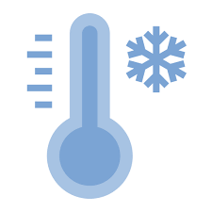
Distress Tolerance - TIPP
Temperature
This strategy activates the Dive Reflex: When mammals dive into cold water, our bodies automatically activate the PNS to preserve oxygen and help us survive under cold water
Intense Exercise
Place your face in cold water while holding your breath OR hold a cold pack on eyes and cheeks while tilting your head down and holding your breath
Do brief, but intense, aerobic exercise for a short while (less than 15 minutes) to let out stored up energy

Slide 26
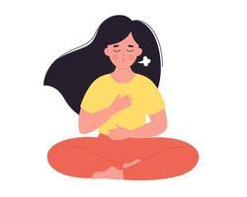
Distress Tolerance - TIPP
Paced Breathing
Progressive Muscle Relaxation
Use counting to breathe out longer than you breathe in (e.g., in for 5, out for 7)
Tense and relax each muscle group from head to toe https://www.youtube.com/watch?v=1nZEdqcGVzo
Handout: https://in.nau.edu/wp-content/uploads/sites/202/TIP-Skills.pdf

Slide 27
Distress Tolerance – Calm Harm App
Website: https://calmharm.stem4.org.uk
Notes:
From the website: “The Calm Harm app provides some immediate activities and techniques to help you break the cycle of self-harm behaviour and explore underlying trigger factors; the app supports you in building a ‘safety net’ of helpful thoughts, behaviours, and access to supportive people, as well as providing the opportunity to journal and self-reflect.”
The app was created to be a free resource, although some app stores (e.g., Apple) now charge up to $2

Slide 28
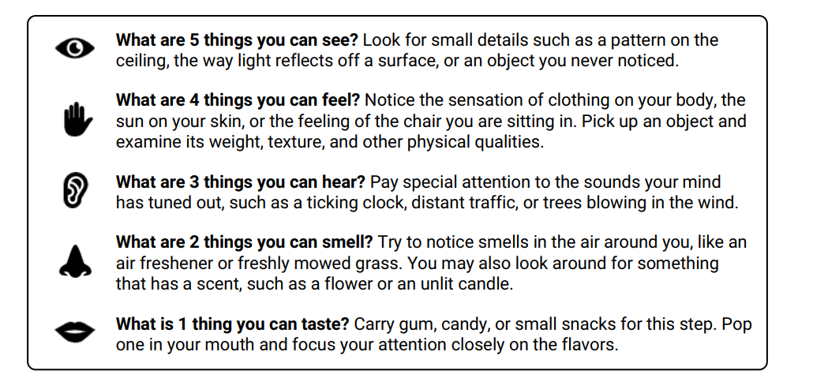
Mindfulness – Grounding Exercises
For teens who experience safety concerns when feeling overwhelmed, grounding exercises can be useful tools to quiet the mind and focus on the present moment
Handout: https://www.therapistaid.com/worksheets/grounding-techniques

Slide 29
Follow-Up Care Documentation
Sam and their mother agreed to follow this safety plan until the next appointment with me, which is scheduled in two weeks. They have been referred to psychiatry. They agreed to call the office if symptoms worsen or they are no longer able to follow the safety plan, and present to the nearest emergency room with immediate safety concerns.
Resources:
Calm Harm App: https://calmharm.stem4.org.uk
TIPP Skills: https://in.nau.edu/wp-content/uploads/sites/202/TIP-Skills.pdf
Progressive Muscle Relaxation Video: https://www.youtube.com/watch?v=1nZEdqcGVzo
Grounding Techniques: https://www.therapistaid.com/worksheets/grounding-techniques
Dot Phrase: .SAFETYPLANHRK

Slide 30
Summary
Assessment
SI: Plan, Intent, Access, Actions
SH: Access, Severity, After-Care
Emergency Department?
Consider ability to remove access to means, adult supervision, parent confidence in keeping them safe
Safety Plan
Adult Supports, Professional Supports, Environmental Safety, Reasons to Live
Follow-Up Care
ED if unable to follow the plan or symptoms worsen
Referral to psychology/psychiatry (if not already connected) and follow-up with you
Coping Strategies
Provide resources (Calm Harm App, TIPP, Grounding)
Yes, if current SI, plan, access, and intent
Notes:
Main points to prioritize, especially if there is limited time in the appointment

Slide 31
References
Farkas, B. F., Takacs, Z. K., Kollarovics, N., & Balazs, J. (2024). The prevalence of self-injury in adolescence: a systematic review and meta-analysis. European Child & Adolescent Psychiatry, 33(10), 3439-3458.
Ivey-Stephenson AZ, Demissie Z, Crosby AE, et al. Suicidal Ideation and Behaviors Among High School Students — Youth Risk Behavior Survey, United States, 2019. MMWR Suppl 2020;69(Suppl-1):47–55. DOI: http://dx.doi.org/10.15585/mmwr.su6901a6.
Gutierrez, P. M., Osman, A., Barrios, F. X., & Kopper, B. A. (2001). Development and initial validation of the Self-Harm Behavior Questionnaire. Journal of Personality Assessment, 77(3), 475-490.
Posner, K., Brent, D., Lucas, C., Gould, M., Stanley, B., Brown, G., ... & Mann, J. (2008). Columbia-suicide severity rating scale (C-SSRS). New York, NY: Columbia University Medical Center, 10, 2008.
Suarez, N. A., Trujillo, L., McKinnon, I., Mack, K., Lyons, B., Robin, L., Carman-McClanahan, M., Pampati, S., Cezair, K., & Ethier, K. (2024). Disparities in school connectedness, unstable housing, experiences of violence, mental health, and suicidal thoughts and behaviors among transgender and cisgender high school students—Youth Risk Behavior Survey, United States, 2023. MMWR supplements, 73.

