Slide 1
Pointers and Pitfalls for Posters and Platforms
Mike Pitt, MD | University of Minnesota

Slide 2

No relevant financial
disclosures
I am occasionally written into grant proposals as a design consultant

Slide 3

– Warning –
This paradigm was made up in my head

Slide 4


Slide 5

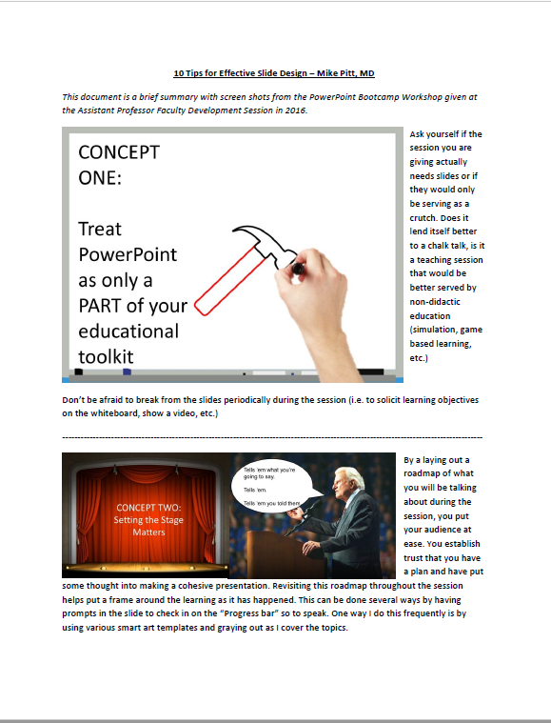


Slide 6

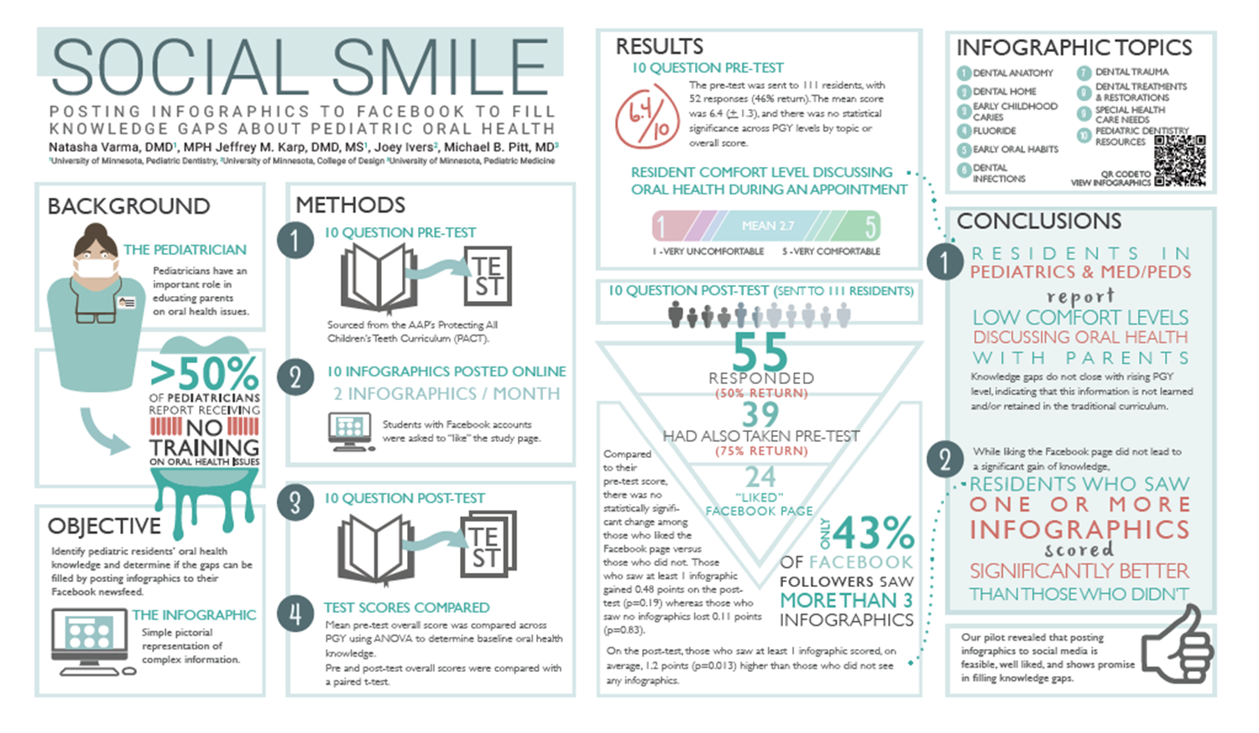


Slide 7




Slide 8

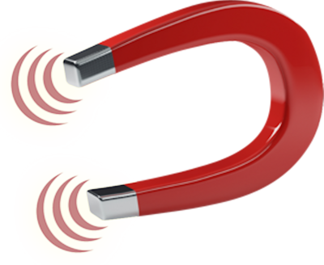

Slide 9

CONCEPT ONE:
What’s in a Name? Don’t Underestimate The Importance of Title
Alexander’s Bad Day

Slide 10
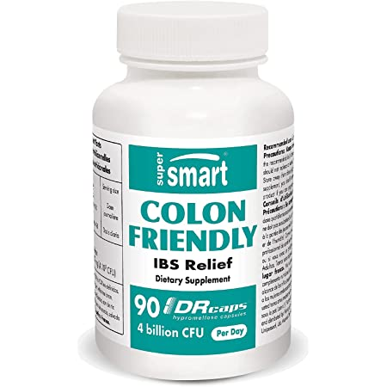
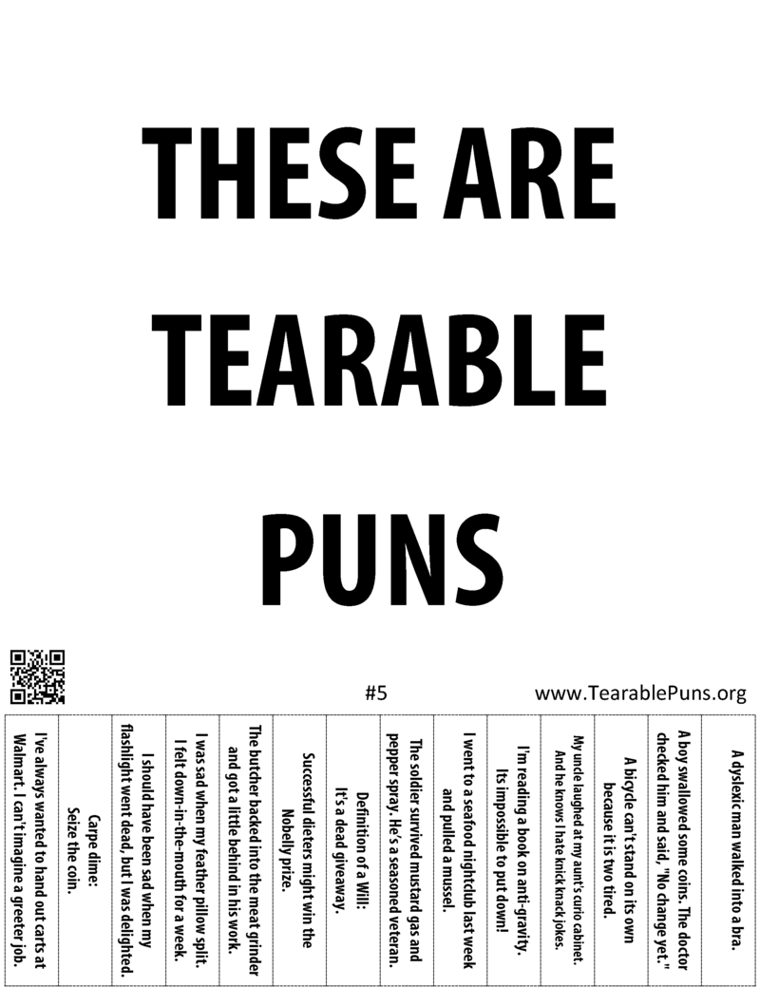

Slide 11
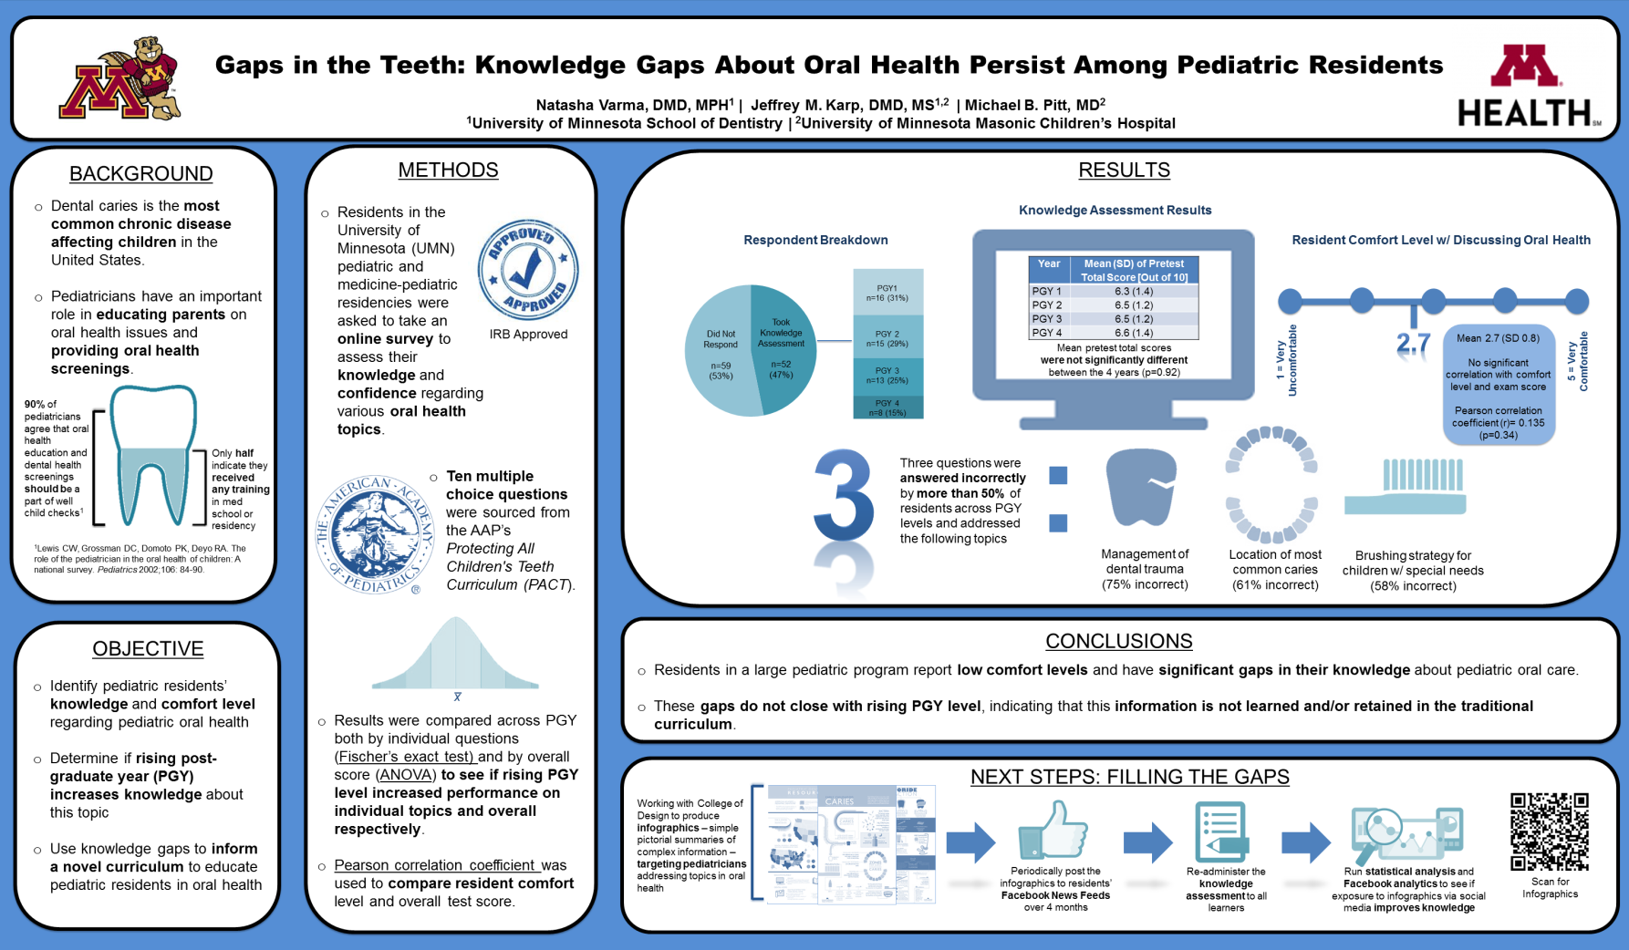

Slide 12


Slide 13
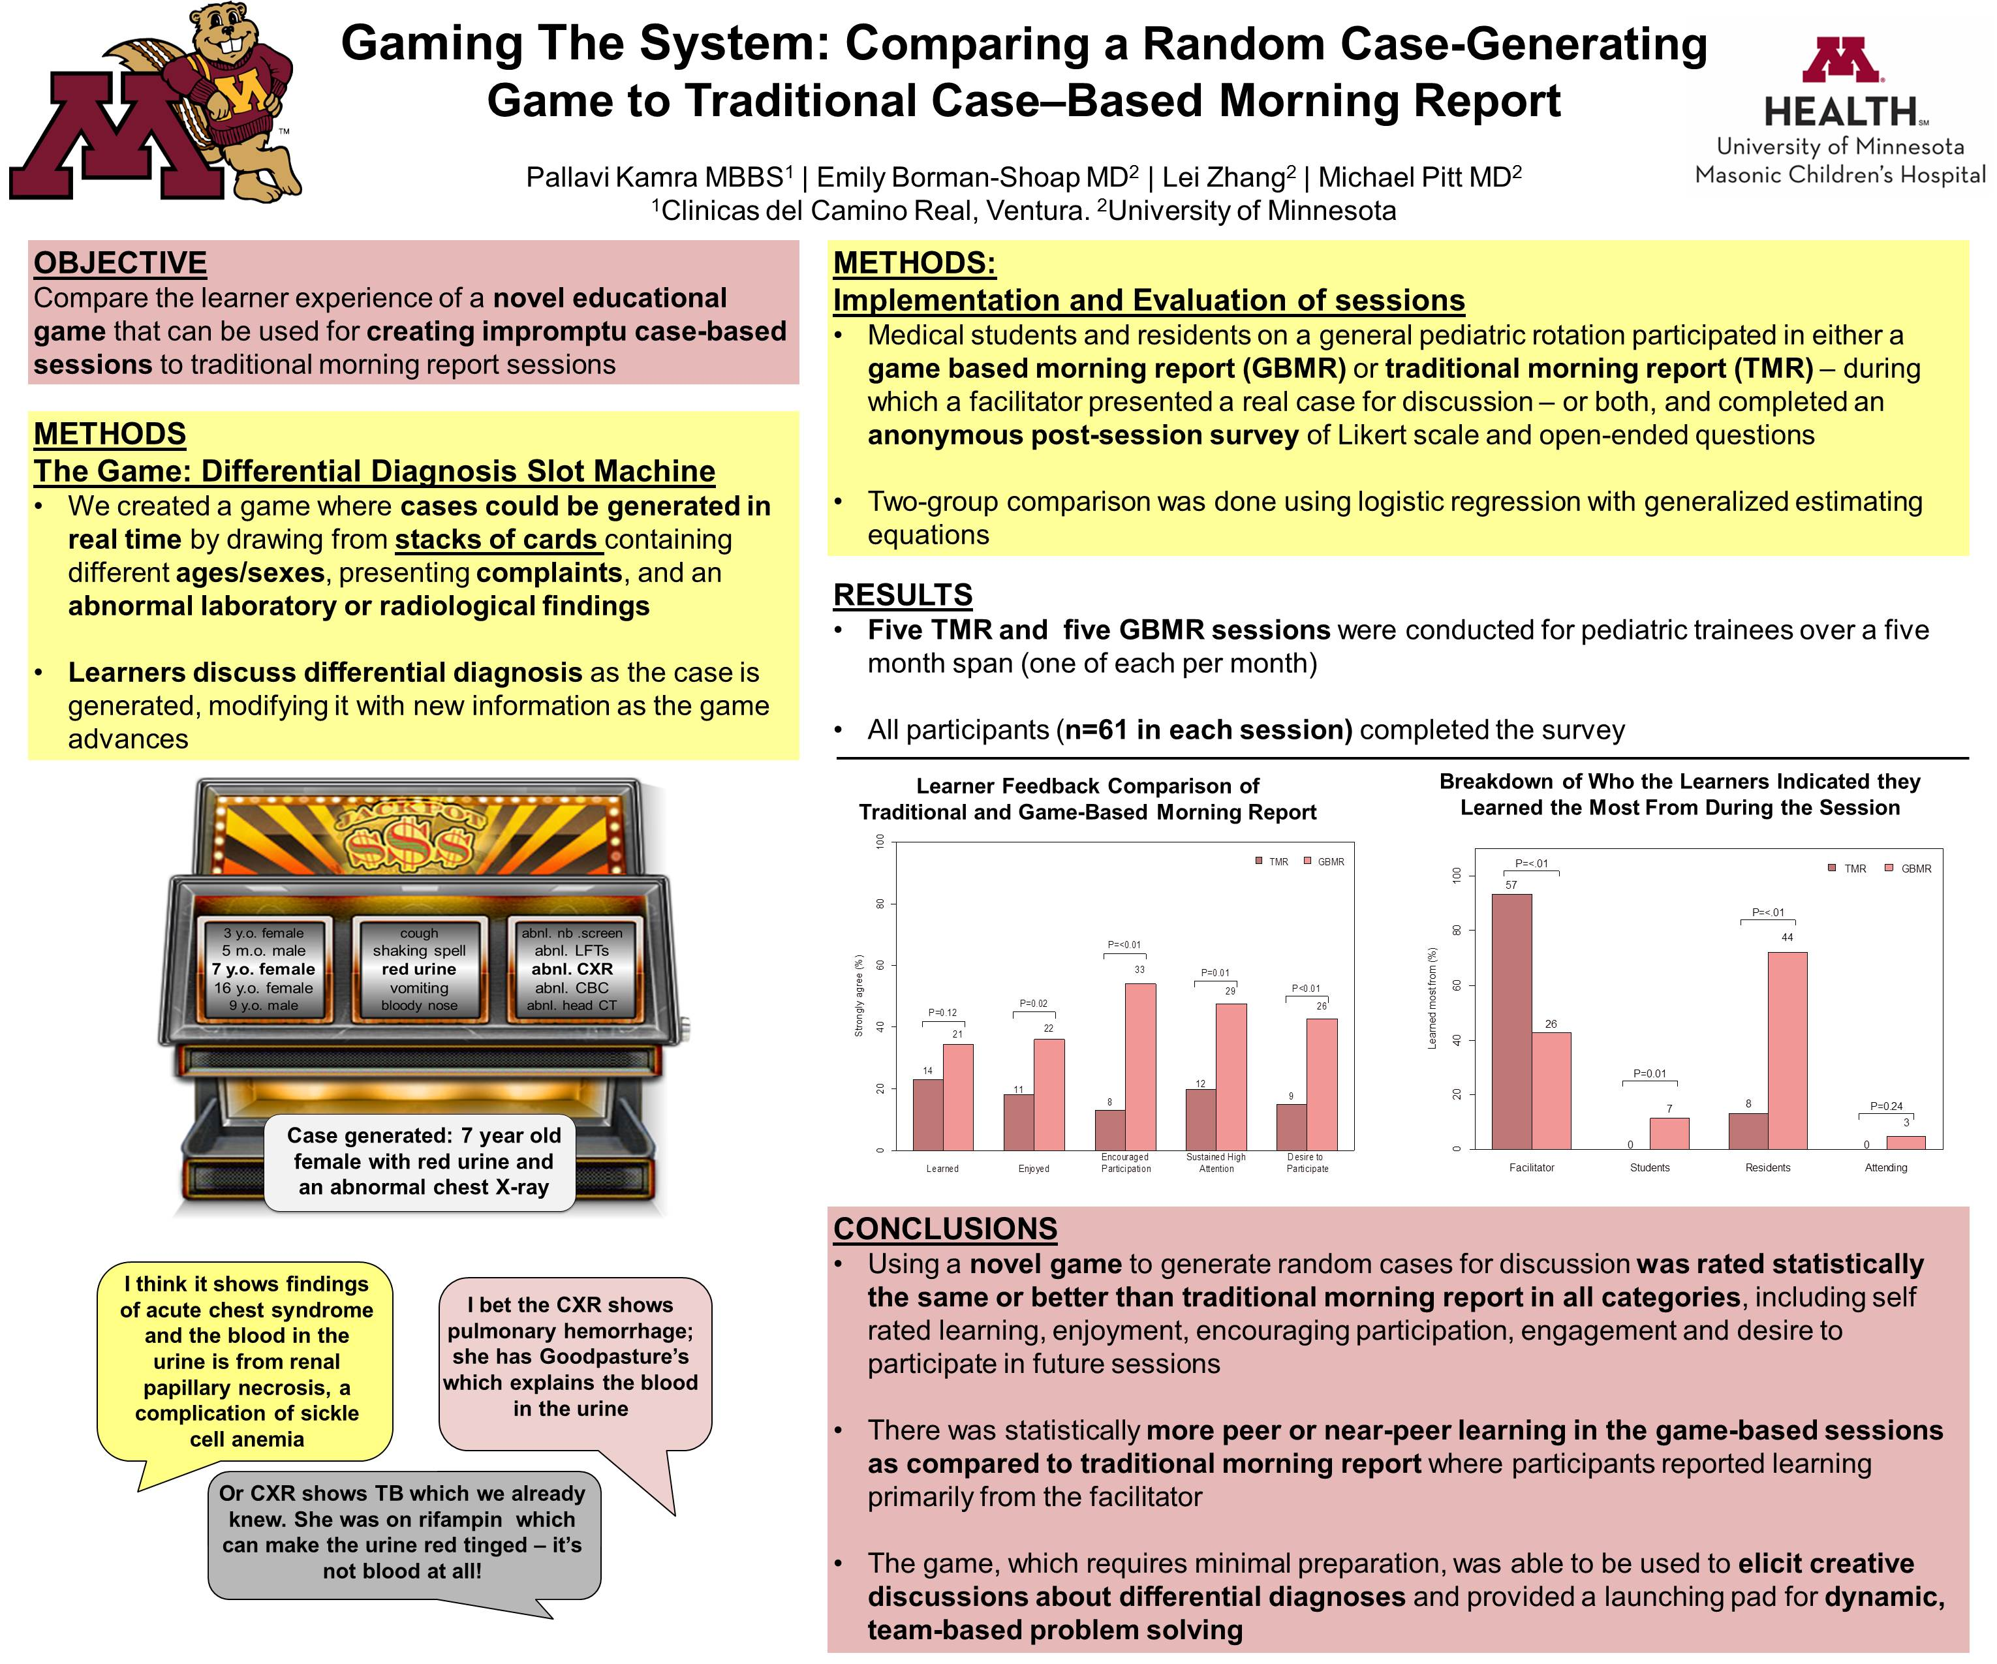

Slide 14
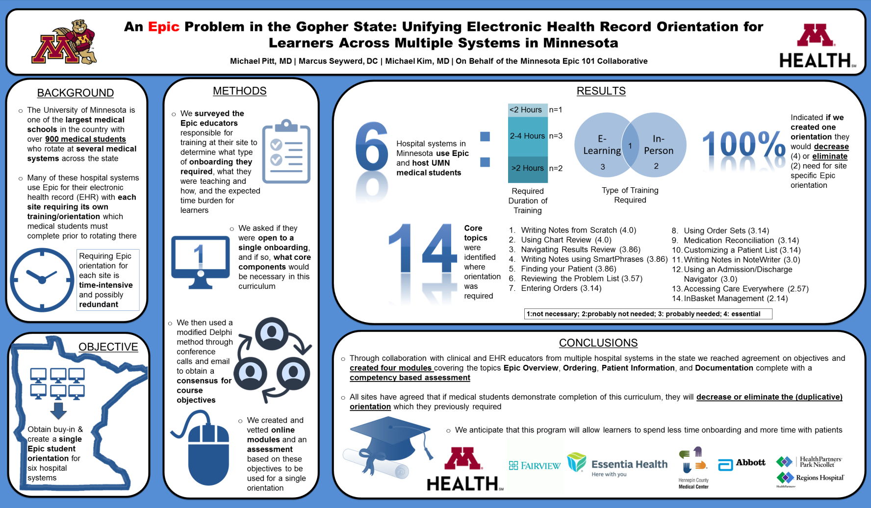

Slide 15
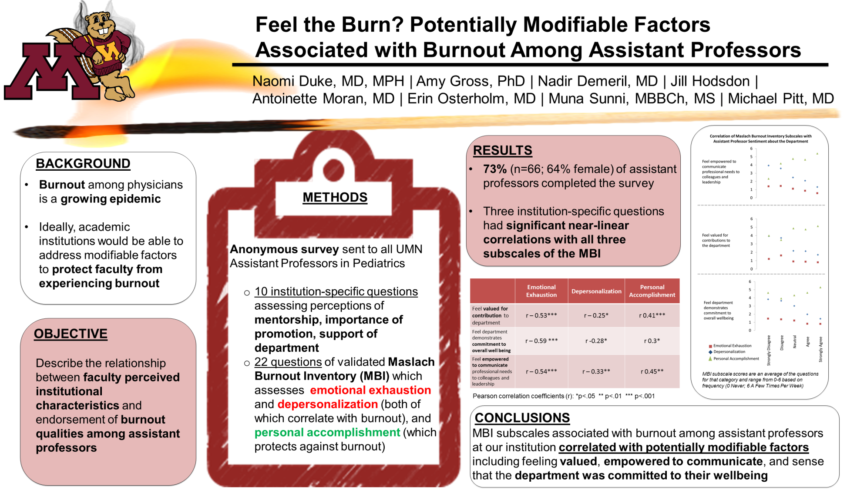

Slide 16
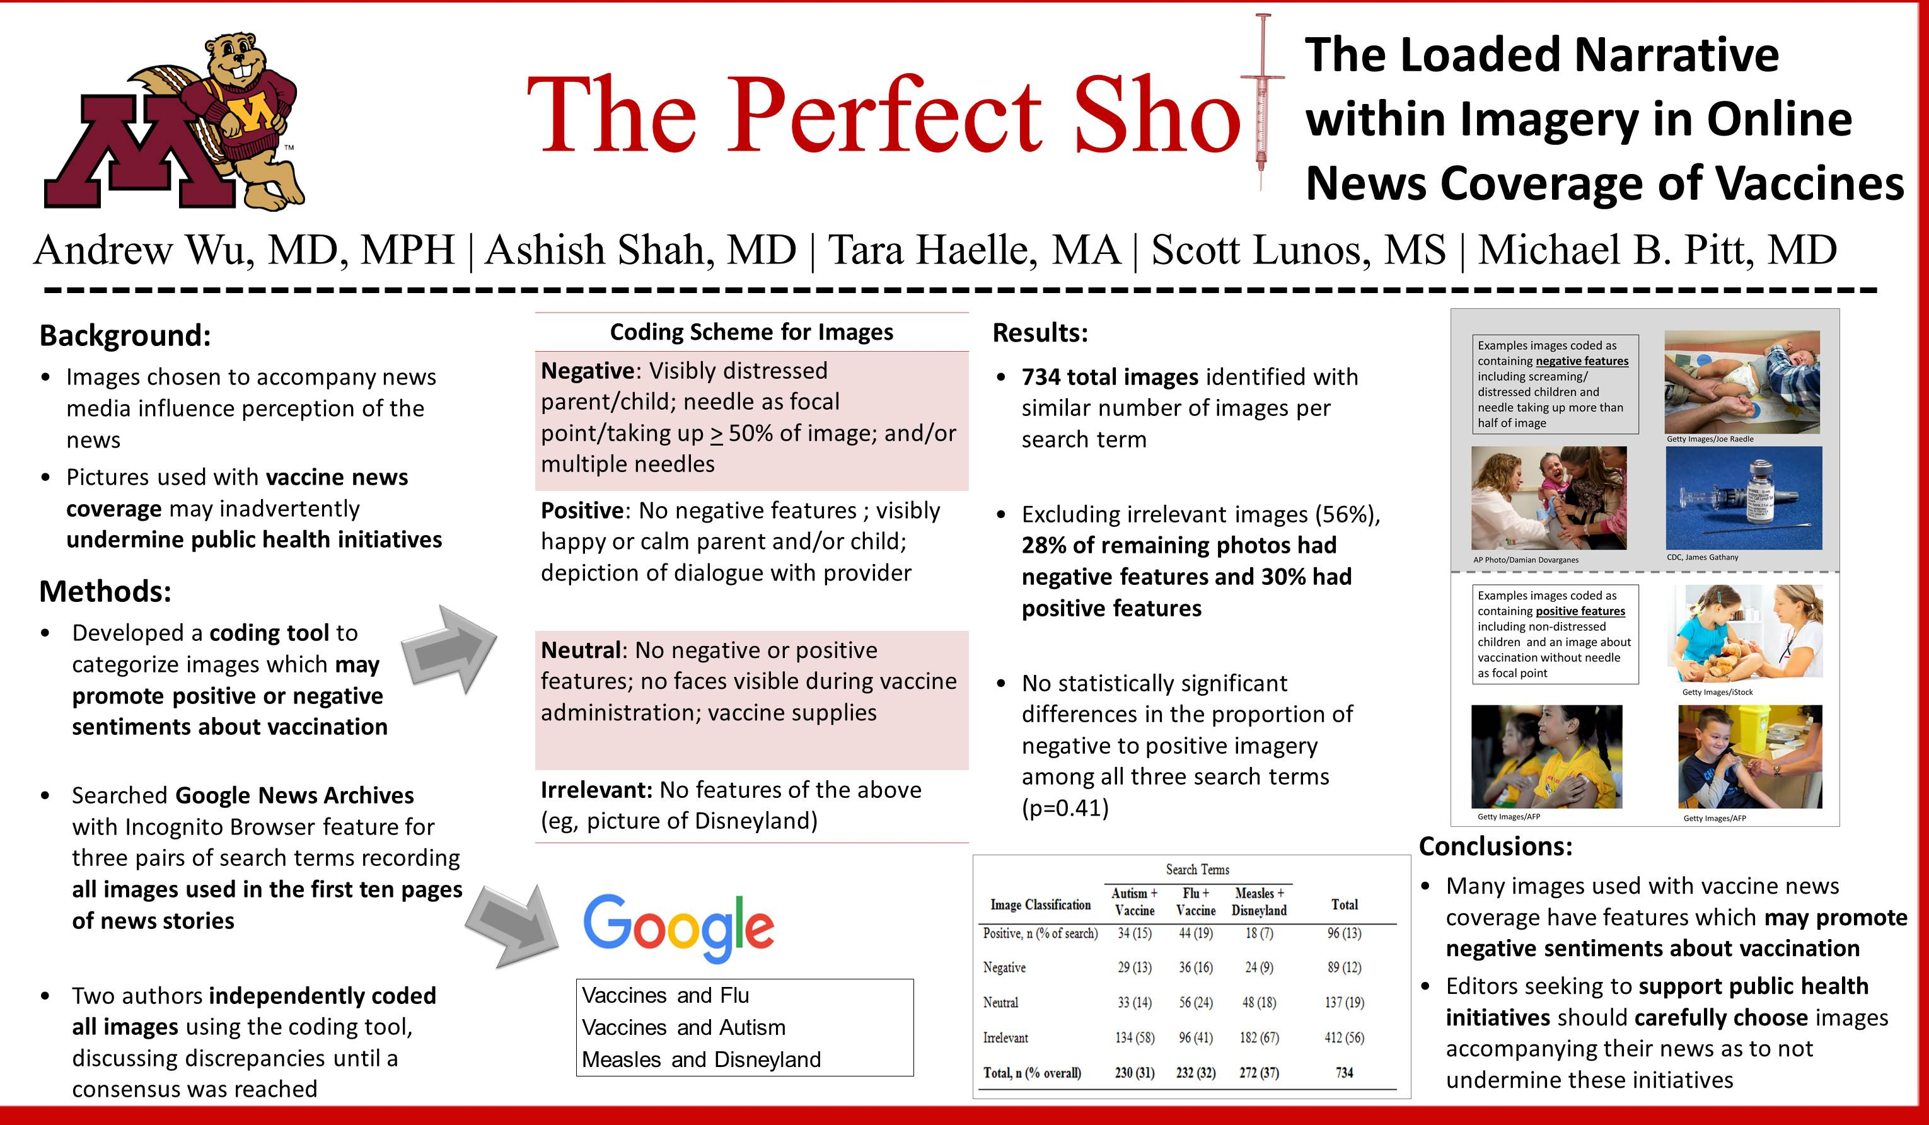

Slide 17


Slide 18
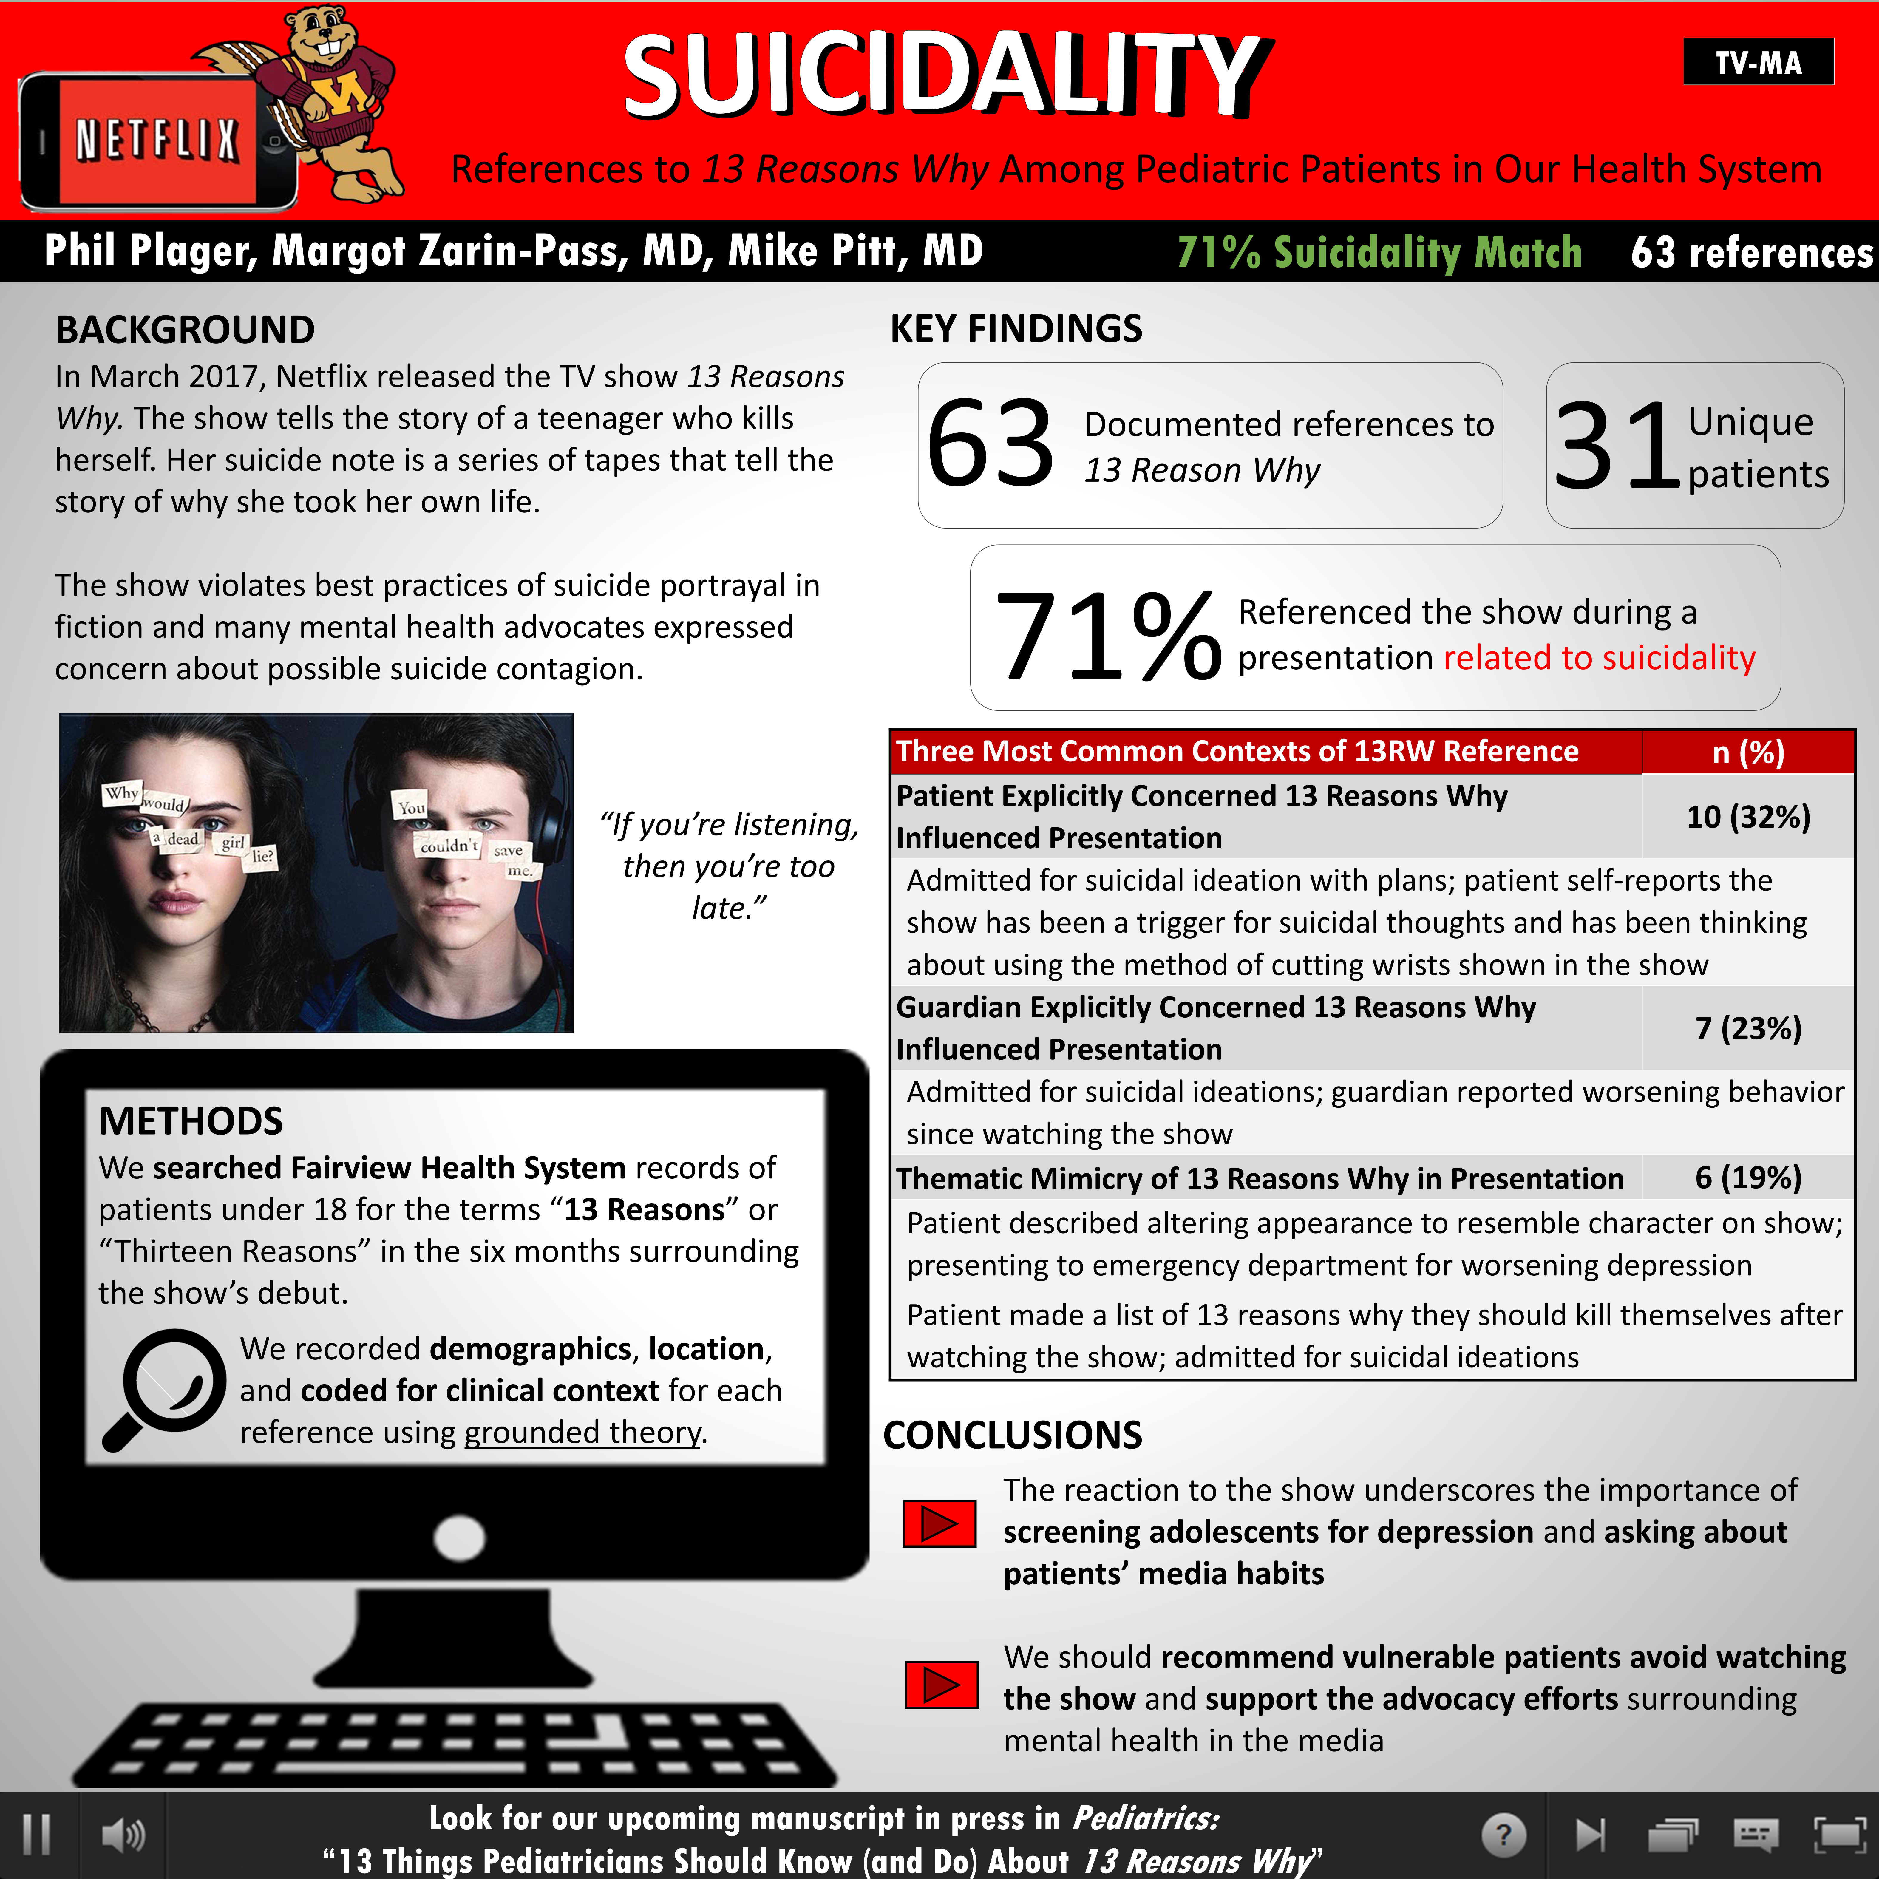

Slide 19
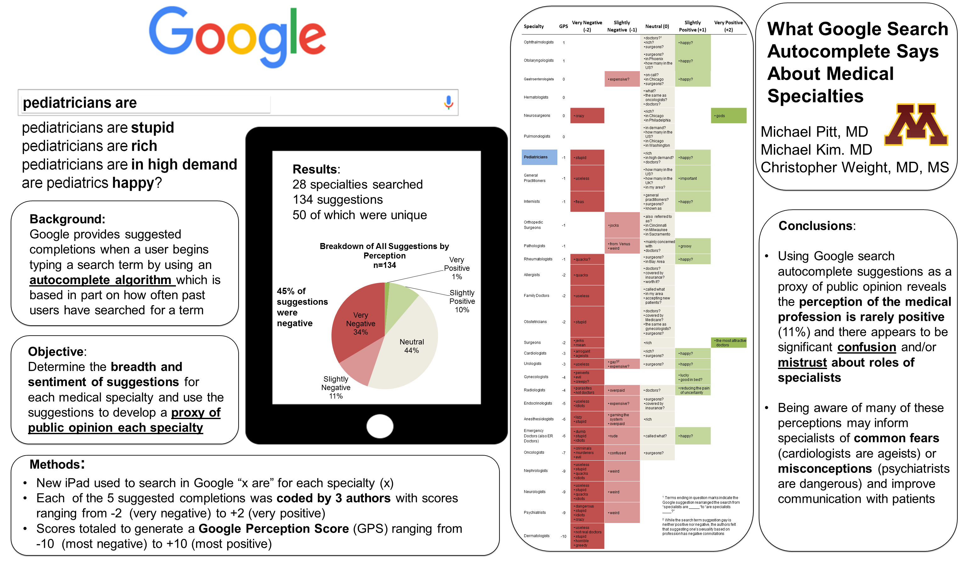

Slide 20
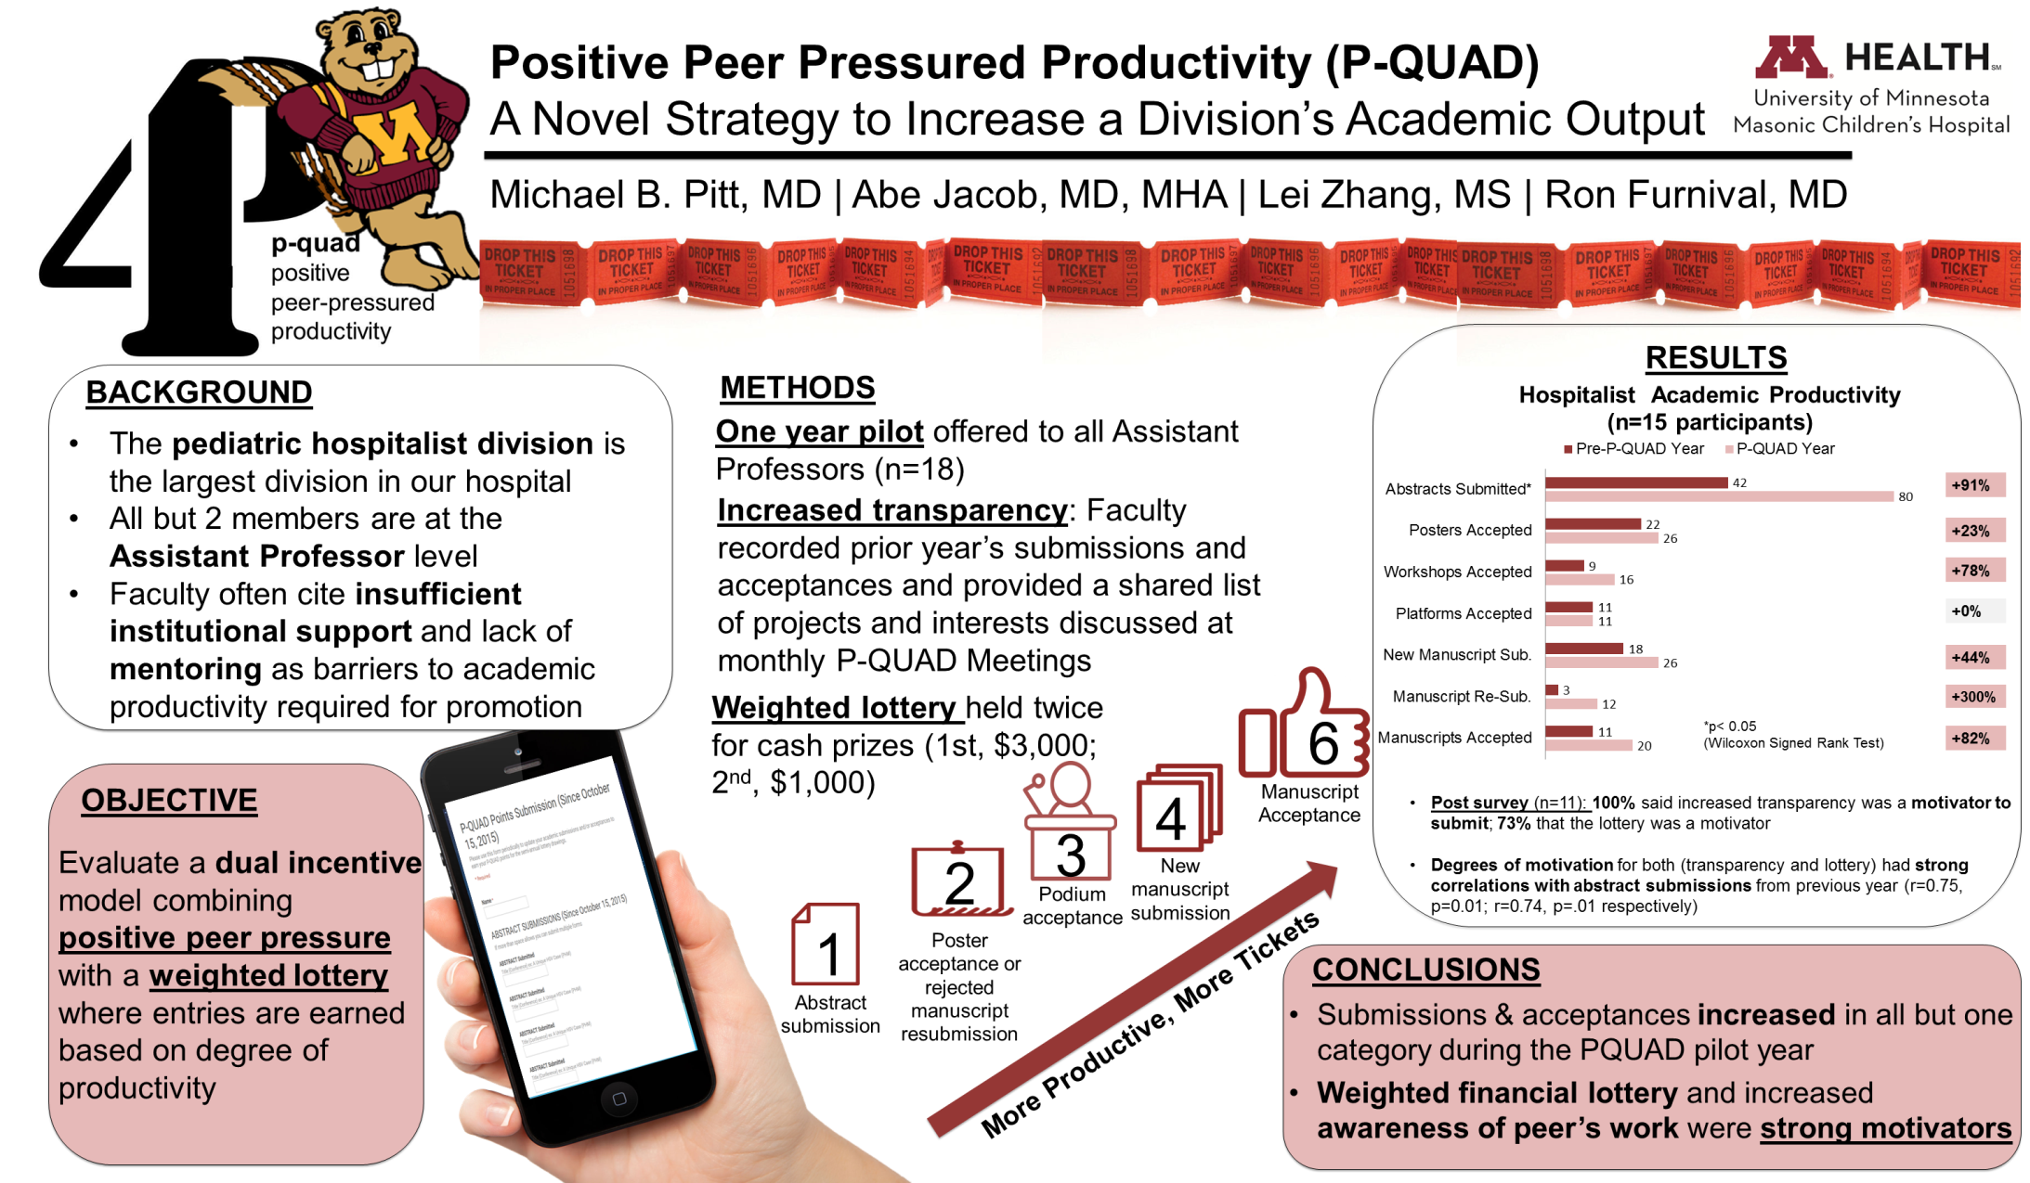

Slide 23


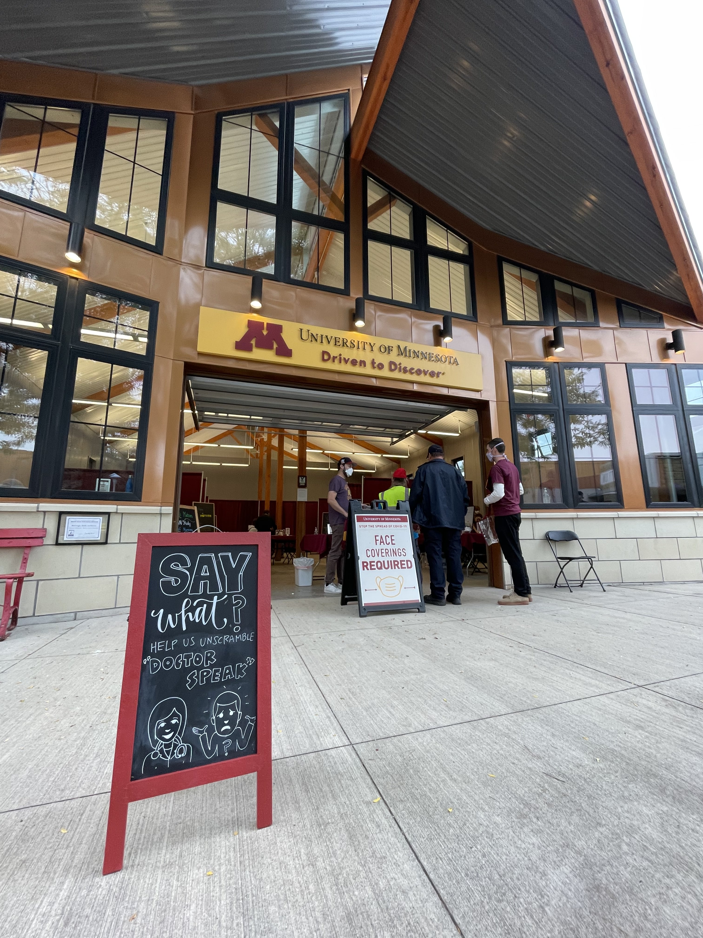


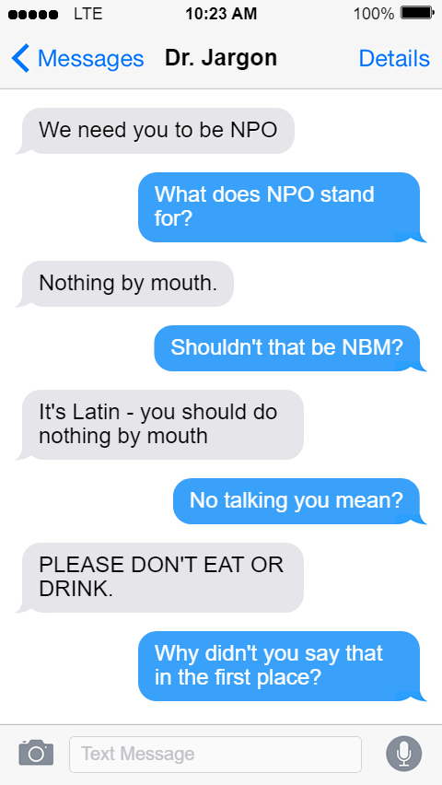

CBC, NPO, WTF? . . . Laypeople's (Mis)Understanding of Acronyms
Victoria Charpentier | Kate Allen | Corinne Praska | Rachael Gotlieb | Emily Hause
Jordan Marmet | Marissa Hendrickson | Scott Lunos | Michael Pitt
OBJECTIVE
METHODS
RESULTS
Abbreviations are used often in medicine and may be a source of confusion for patients.
We aimed to determine the general public’s understanding of commonly used medical acronyms.
204 respondents
55% female
Mean age 43
67% with bachelor’s degree or higher
We surveyed adults without medical training at the 2022 Minnesota State Fair via a voluntary, anonymous, iPad-based free-text survey.
Acronym | Don’t Know | Incorrect | Partially Correct | Correct
ED | 43% | 25% | 0% | 32%
PCP | 61% | 21% | 0% | 18%
CBC | 62% | 19% | 4% | 14%
NPO | 12% | 73% | 3% | 13%
PRN | 65% | 22% | 0% | 13%
Participants were asked to imagine they were in their doctor’s office, and heard each of the following statements:
  Did you go to the ED?
  Do you have a PCP?
  We will need to get a CBC?
  You will need to be NPO.
  We will make that PRN.
Two demographic variables were associated with statistically significant differences in understanding:
  Women were more likely to understand NPO than men (17.7% correct vs. 6.6%) [aOR (95% CI) = 3.11 (1.18-8.21); p = 0.02]
  Older respondents were increasingly more likely to understand PRN [aOR (95% CI) = 1.03 (1.00-1.05), p=0.04)
After each statement, they were asked to write out what they believed the abbreviation meant.
Two researches scored responses for degree of understanding (correct, partially correct, incorrect, don’t know). Participants did not need to know what the letters actually stood for to be scored as correct.
CONCLUSION
Medical acronyms are a predictable source of confusion. Less than one in five people accurately understood the acronyms ED, PCP, PRN, CBC, or NPO.
As we work to improve our communication with patients, we should pay specific attention to our use of acronyms and abbreviations.

Slide 24

A
Short Story not a Novel
CONCEPT TWO:
A poster should tell a simple story (why, how, what, what next)

Slide 25

A poster is a VISUAL abstract – not just a printed abstract blown up to 4x3 feet

Slide 26
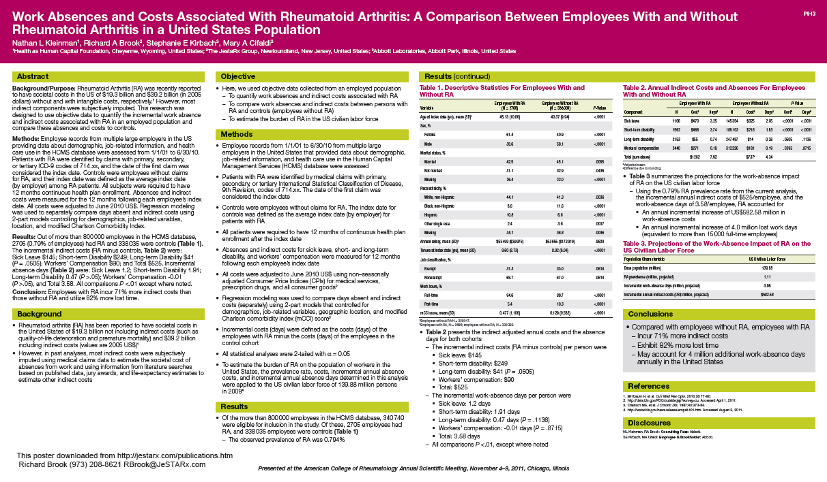


Slide 27
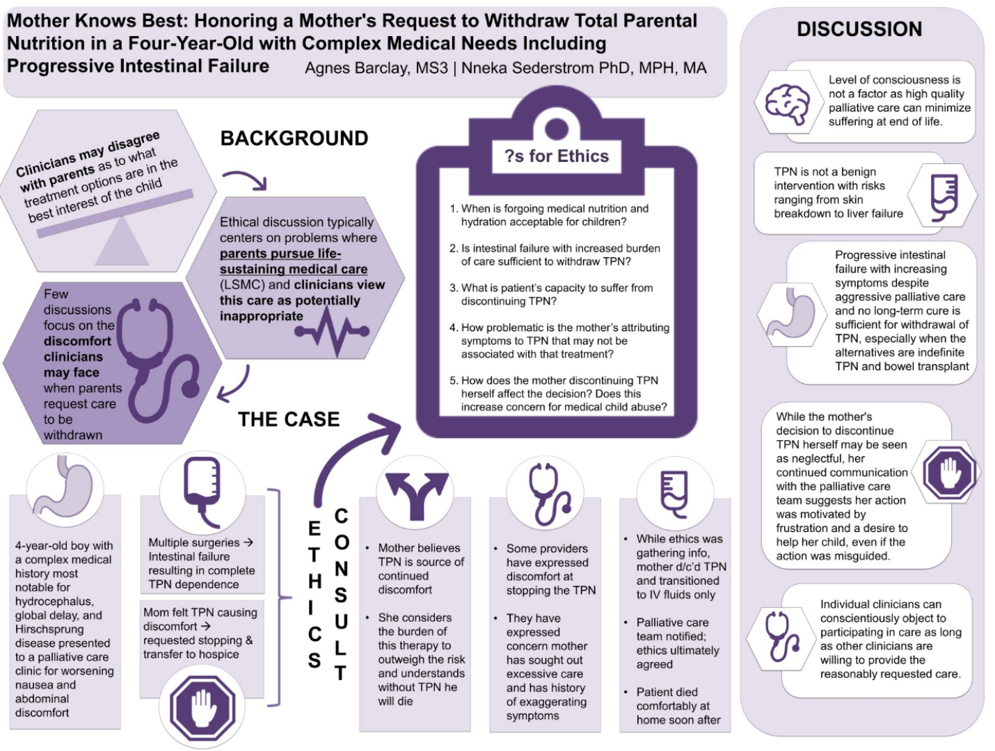
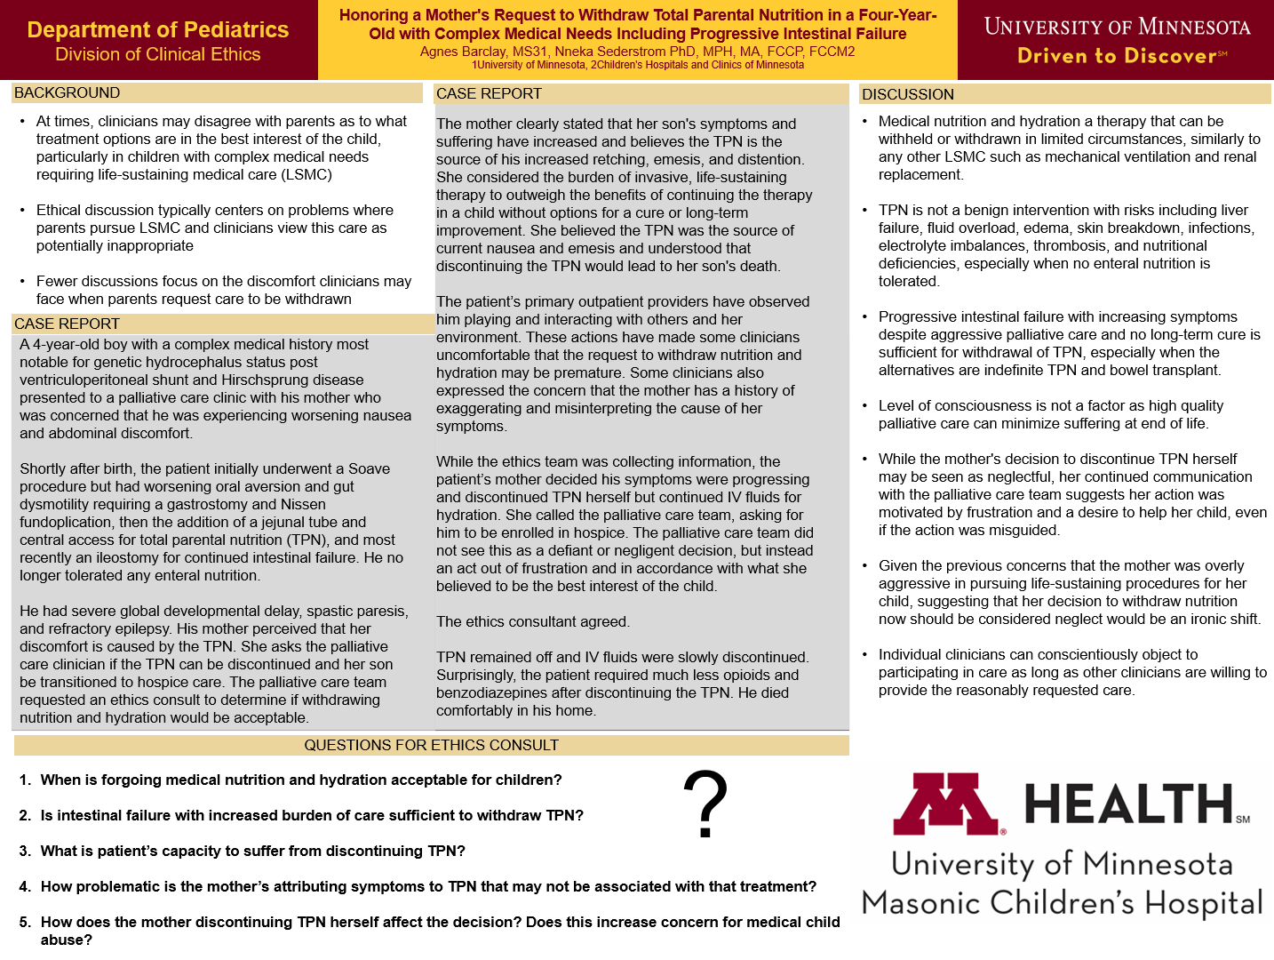

Slide 28
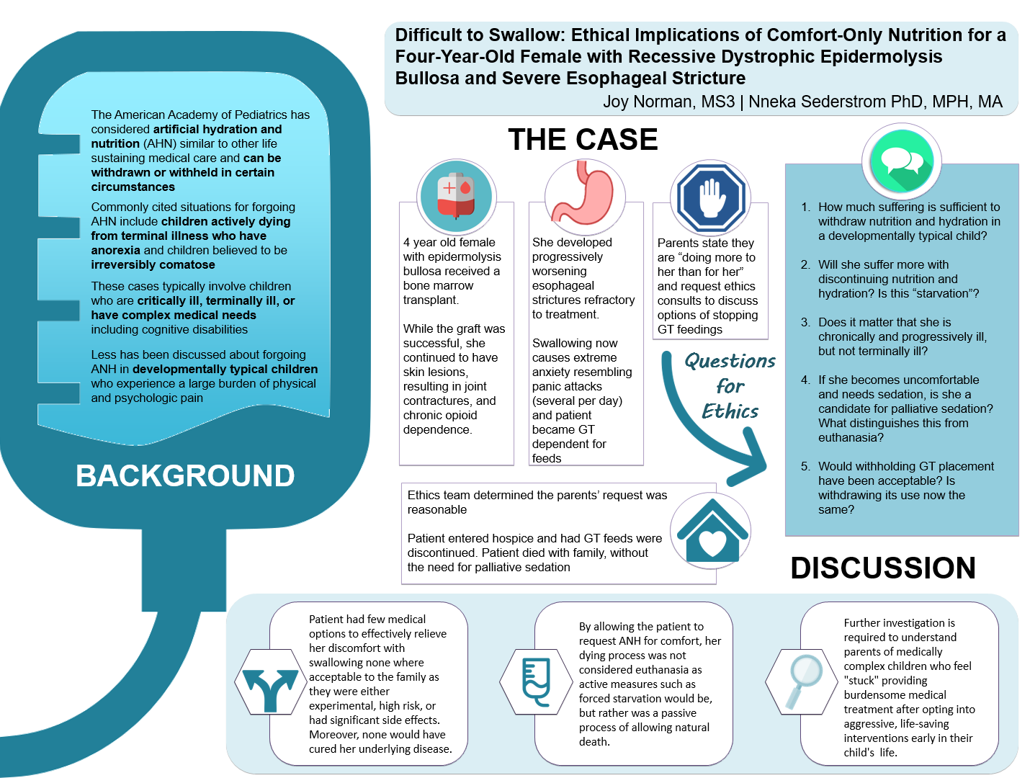
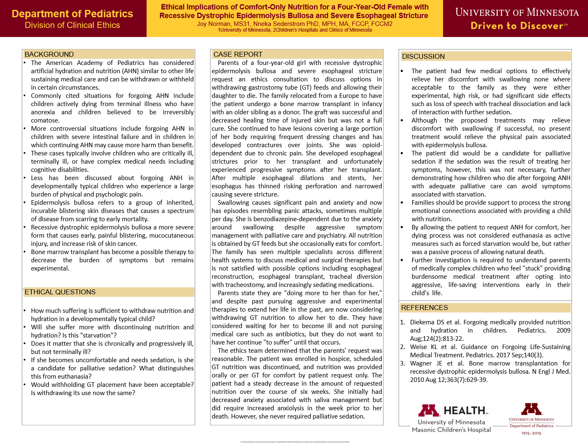

Slide 29
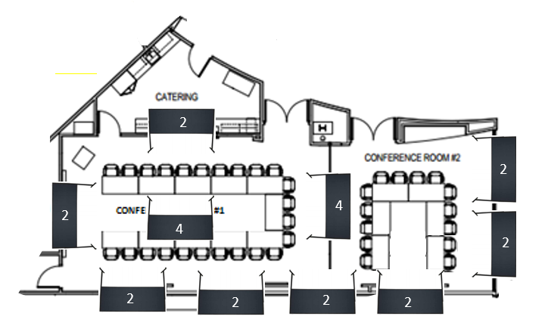


Observer positioned to view Poster 1
Observer positioned to view poster 2
Poster 1: Mother Knows Best
Poster 2: Difficult to Swallow

Slide 30

CONCEPT THREE
Once Size Does Not Fit All

Slide 31

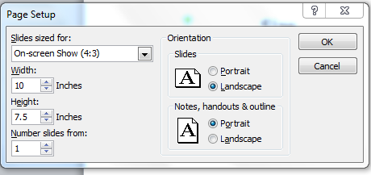
Adjust the size to the poster specifications for specific conference here:

Slide 32

CONCEPT FOUR:
Resist the Temptation of the Template of Doom

Slide 33
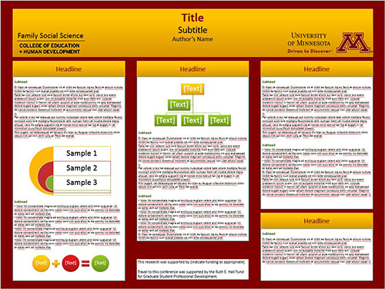
PAS circa any year

Slide 34

Embrace the blank canvas

Slide 35


Gaming The System: Comparing a Random Case-Generating Game to Traditional Case–Based Morning Report
Pallavi Kamra MBBS¹ | Emily Borman-Shoap MD² | Lei Zhang² | Michael Pitt MD²
Step 1: Start with the Header (Title, Authors, Logos)

Slide 36
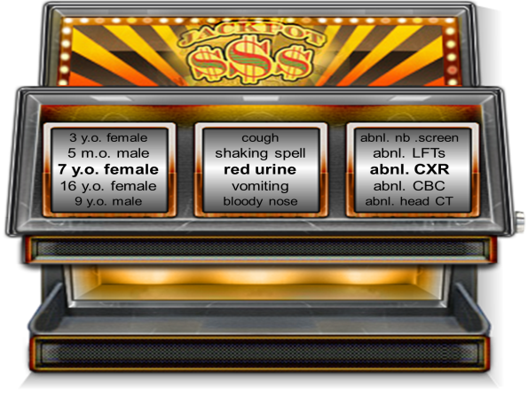
Gaming The System: Comparing a Random Case-Generating Game to Traditional Case–Based Morning Report
Pallavi Kamra MBBS¹ | Emily Borman-Shoap MD² | Lei Zhang² | Michael Pitt MD²
Step 2: Paste in any Essential Visuals
Case generated: 7 year old female with red urine and an abnormal chest X-ray
I think it shows findings of acute chest syndrome and the blood in the urine is from renal papillary necrosis, a complication of sickle cell anemia
I bet the CXR shows pulmonary hemorrhage; she has Goodpasture’s which explains the blood in the urine
Or CXR shows TB which we already knew. She was on rifampin which can make the urine red tinged – it’s not blood at all!

Slide 37
Gaming The System: Comparing a Random Case-Generating Game to Traditional Case–Based Morning Report
Pallavi Kamra MBBS¹ | Emily Borman-Shoap MD² | Lei Zhang² | Michael Pitt MD²
Step 3: Start Spacing Out Text Boxes
Case generated: 7 year old female with red urine and an abnormal chest X-ray
I think it shows findings of acute chest syndrome and the blood in the urine is from renal papillary necrosis, a complication of sickle cell anemia
I bet the CXR shows pulmonary hemorrhage; she has Goodpasture’s which explains the blood in the urine
Or CXR shows TB which we already knew. She was on rifampin which can make the urine red tinged – it’s not blood at all!

Slide 38
Gaming The System: Comparing a Random Case-Generating Game to Traditional Case–Based Morning Report
Pallavi Kamra MBBS¹ | Emily Borman-Shoap MD² | Lei Zhang² | Michael Pitt MD²
Case generated: 7 year old female with red urine and an abnormal chest X-ray
I think it shows findings of acute chest syndrome and the blood in the urine is from renal papillary necrosis, a complication of sickle cell anemia
Step 4: Fill in with the essential text
I bet the CXR shows pulmonary hemorrhage; she has Goodpasture’s which explains the blood in the urine
Or CXR shows TB which we already knew. She was on rifampin which can make the urine red tinged – it’s not blood at all!

Slide 39
Gaming The System: Comparing a Random Case-Generating Game to Traditional Case–Based Morning Report
Pallavi Kamra MBBS¹ | Emily Borman-Shoap MD² | Lei Zhang² | Michael Pitt MD²
¹Clinicas del Camino Real, Ventura. ²University of Minnesota
OBJECTIVE
Compare the learner experience of a novel educational game that can be used for creating impromptu case-based sessions to traditional morning report sessions
METHODS:
Implementation and Evaluation of sessions
Medical students and residents on a general pediatric rotation participated in either a game based morning report (GBMR) or traditional morning report (TMR) – during which a facilitator presented a real case for discussion – or both, and completed an anonymous post-session survey of Likert scale and open-ended questions
METHODS
The Game: Differential Diagnosis Slot Machine
We created a game where cases could be generated in real time by drawing from stacks of cards containing different ages/sexes, presenting complaints, and an abnormal laboratory or radiological findings
RESULTS
Five TMR and five GBMR sessions were conducted for pediatric trainees over a five month span (one of each per month)
All participants (n=61 in each session) completed the survey
Learner Feedback Comparison of
Traditional and Game-Based Morning Report
Breakdown of Who the Learners Indicated they Learned the Most From During the Session
Case generated: 7 year old female with red urine and an abnormal chest X-ray
CONCLUSIONS
Using a novel game to generate random cases for discussion was rated statistically the same or better than traditional morning report in all categories, including self rated learning, enjoyment, encouraging participation, engagement and desire to participate in future sessions
There was statistically more peer or near-peer learning in the game-based sessions as compared to traditional morning report where participants reported learning primarily from the facilitator
I think it shows findings of acute chest syndrome and the blood in the urine is from renal papillary necrosis, a complication of sickle cell anemia
I bet the CXR shows pulmonary hemorrhage; she has Goodpasture’s which explains the blood in the urine
Or CXR shows TB which we already knew. She was on rifampin which can make the urine red tinged – it’s not blood at all!

Slide 40
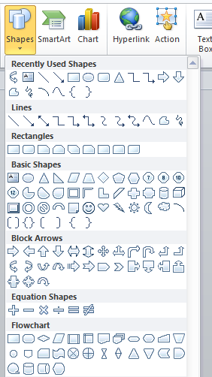

Slide 41
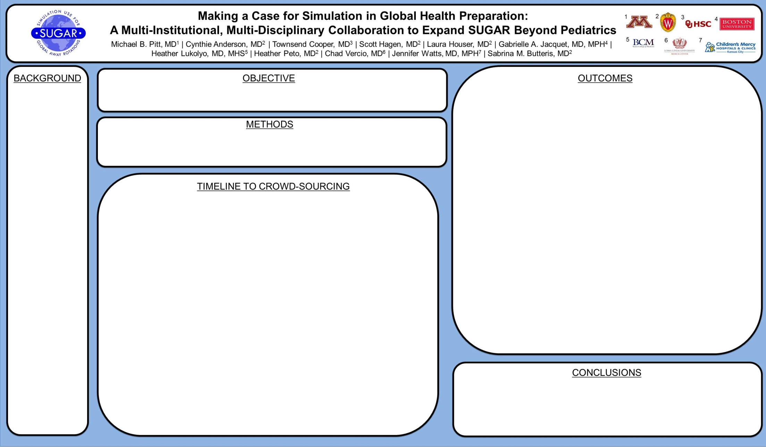

Slide 42
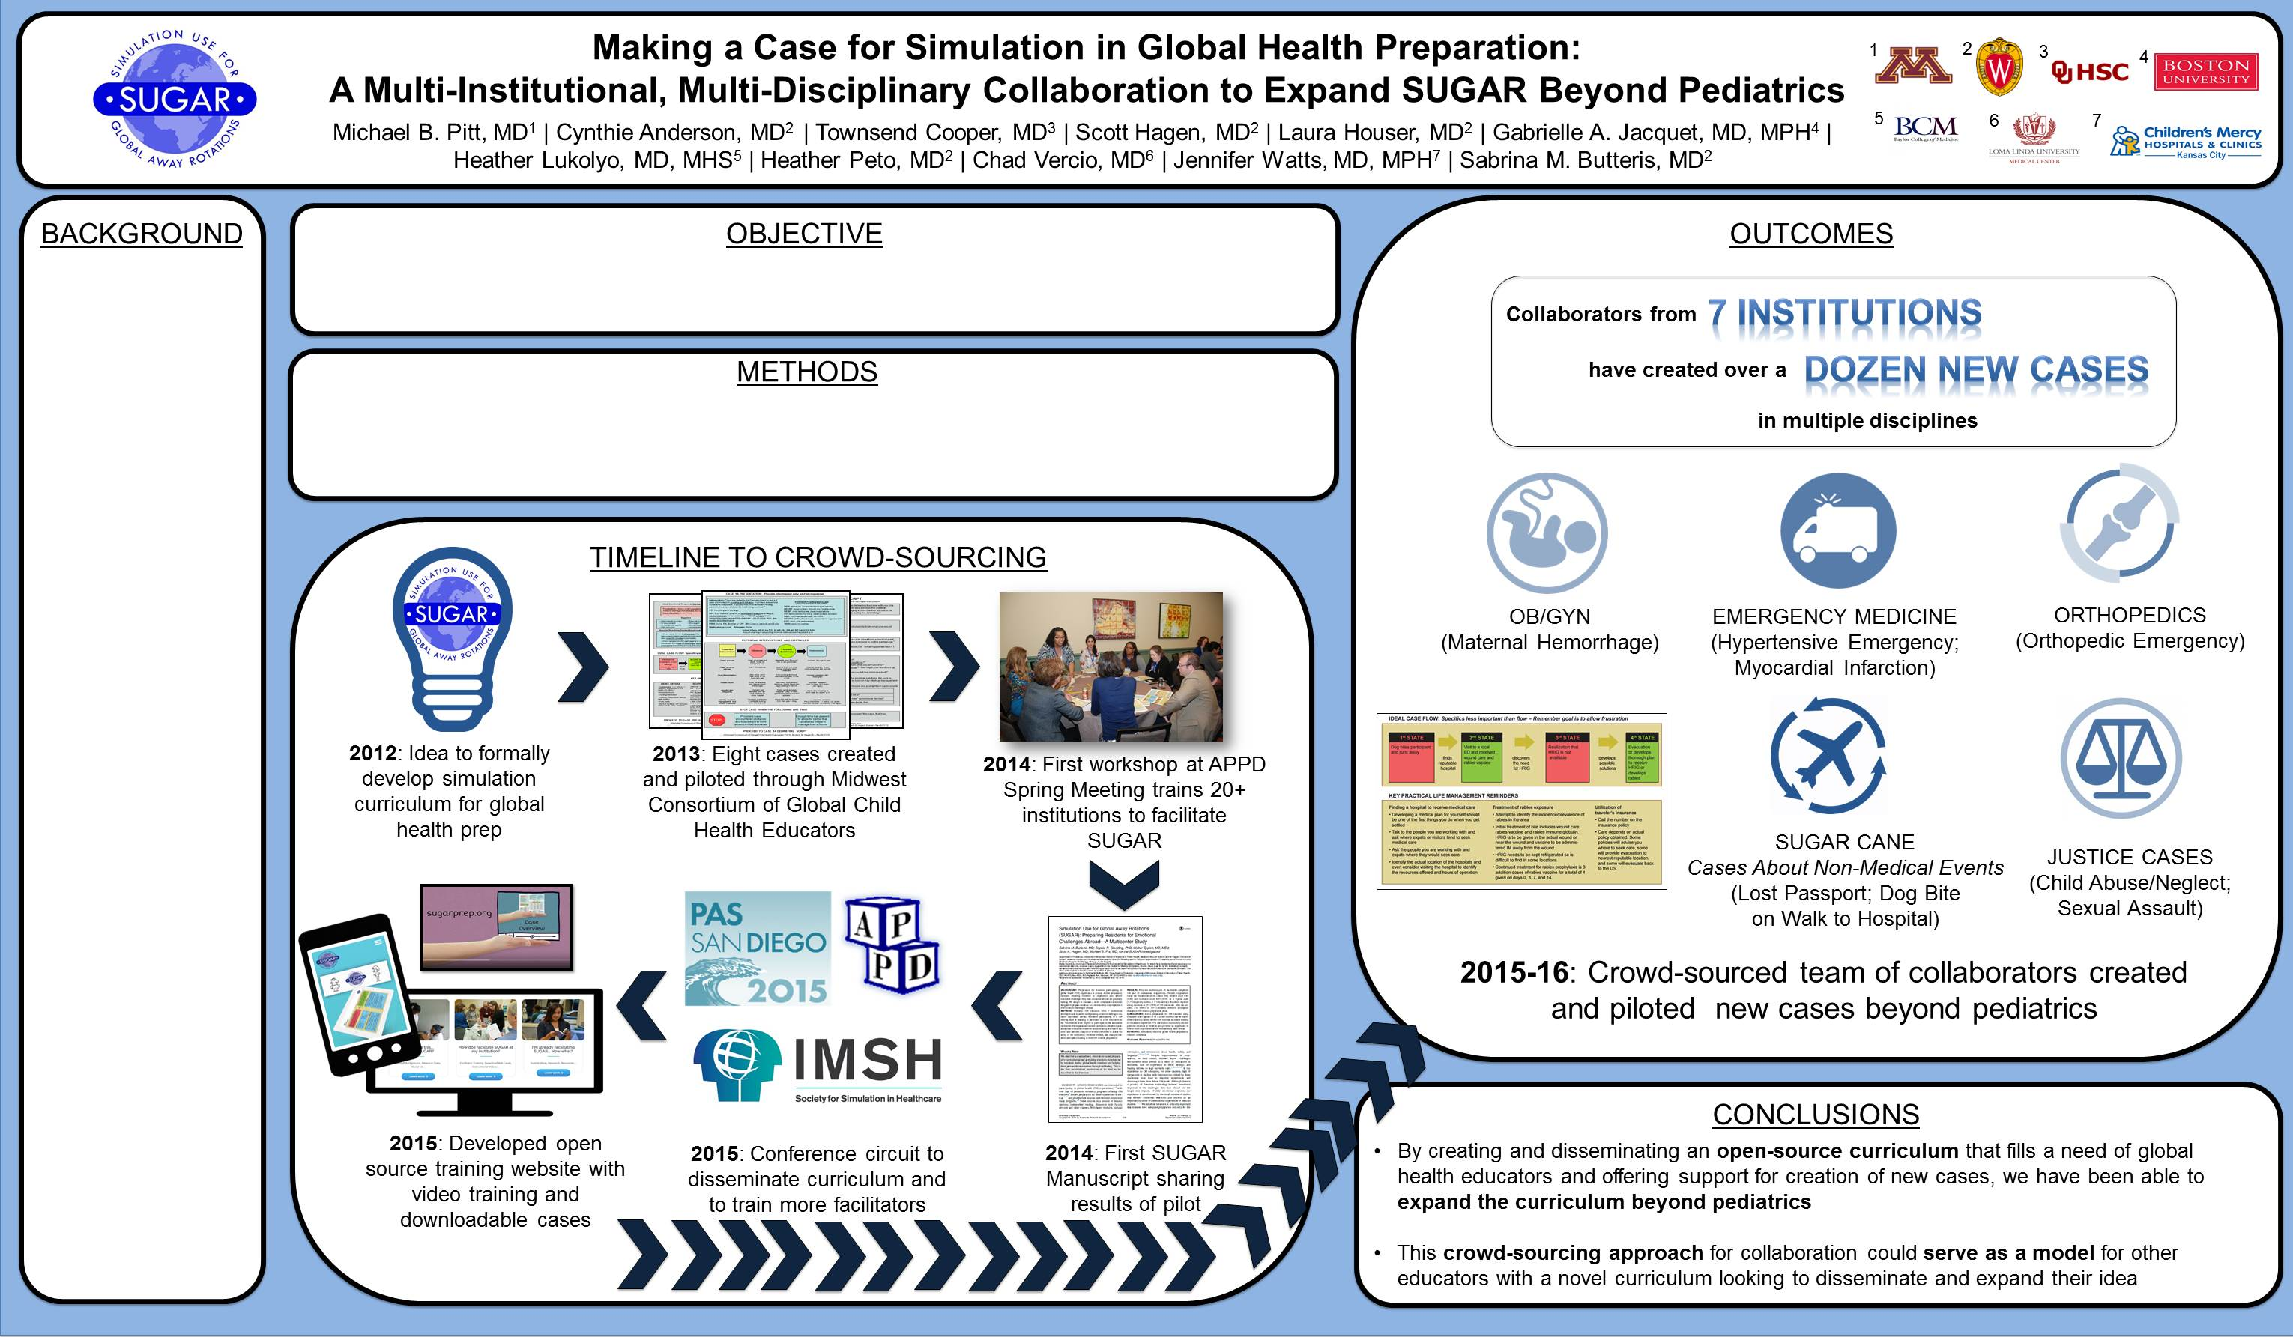

Slide 43
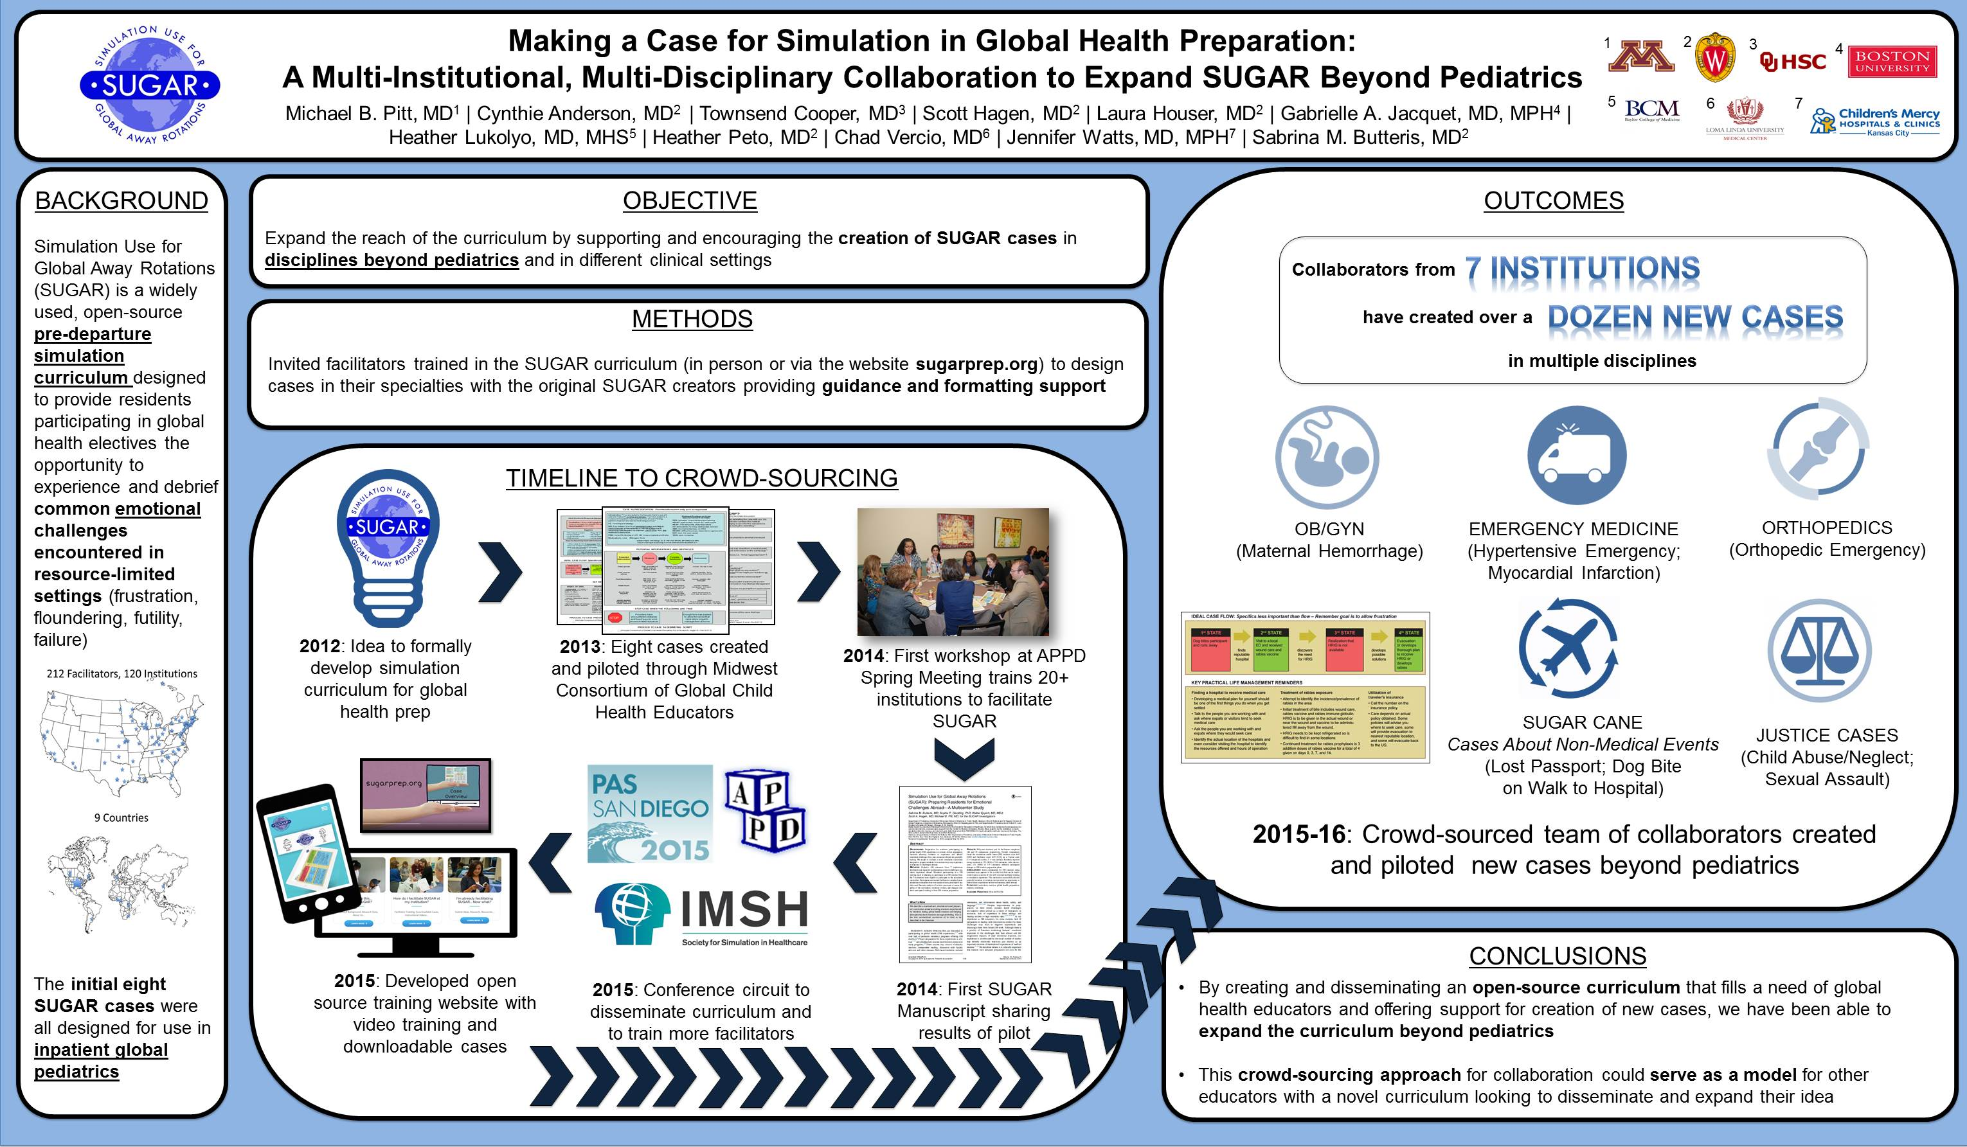

Slide 44


Slide 46








Accepting Rejection as Part of the Job by Tracking Your Personal Rejection Rate – A Novel Metric for Self-Assessment in Scholarship
Michael B. Pitt | Deborah Finstad | Andrew Slattengren
BACKGROUND: While researchers typically report their academic successes (i.e. publications), little is known about the frequency of rejection encountered along the way to publication
RESULTS:
58% (34)
of eligible faculty completed the survey with 3 excluded for having zero scholarship
OBJECTIVE: Determine the feasibility of obtaining a series of novel metrics in academics aimed at looking at eventual acceptance rate of manuscripts and acceptance rate per submission
Most (71%) were assistant professors
Mean ARPS (SD) = 0.68 (0.33)
Mean ERA (SD) = 0.82 (0.28)
METHODS:
The mean ERA was higher for associate/full professors at 0.97 (0.07) compared to assistant professors at 0.77 (0.32), while ARPS was similar between the two groups [0.64 (0.35) vs. 0.78 (0.28)].
Surveyed all clinical faculty in Pediatrics and Family Medicine with 20 or fewer articles listed in SCOPUS in the last two years
Provided each with a list of their indexed articles and asked the number of unique journal submission (JS) each manuscript (M) required prior to acceptance (A)
We asked the same for articles not indexed or not yet accepted
Acceptance Rate Per Submission (ARPS): A/JS – percent of the time a manuscript is accepted for any given submission to a journal [1 means all manuscripts were accepted on the first attempt]
Eventual Rate of Acceptance (ERA):
M/A – percent of manuscripts submitted that eventually got accepted by a journal [1 means all manuscripts submitted
were eventually published]
CONCLUSIONS: Rejection is common
Physicians in our sample eventually published 82% of the papers submitted in the last two years, with a 68% success rate per submission (32% rejection rate)
Despite similar rejection rates per journal submission among faculty, senior faculty were more likely to eventually find a home for their paper

Slide 47


















HELLO
my name is
Emily Hause | Corinne E. Praska | Michael B. Pitt | Victoria Charpentier | Rachael Gotlieb | Katherine A. Allen | Marissa A. Hendrickson | Scott Lunos | Jordan Marmet
people completed the survey
specialties were understood by < 90%
specialties were understood by < 50%
Medical providers are advised to avoid jargon to minimize confusion
If patients aren’t
familiar with the
names of
specialties or
hospital roles, this confusion may start with the introduction
We surveyed adults without medical backgrounds at the 2021 Minnesota State Fair
55% female
43 years old on average
67% with bachelor’s or higher
Specialist | Correct | Most common wrong answers
Dermatologist | 94% | No repeated wrong answer
Cardiologist | 93% | No repeated wrong answer
Pediatrician | 89% | Feet (2%)
Neurologist | 89% | No repeated wrong answer
Gastroenterologist | 89% | No repeated wrong answer
Geriatrician | 74% | Stomach (3%), Women (2%)
Opthalmologist | 67% | Ear, Nose, or Throat (3%)
Rheumatologist | 56% | Nerves (3%)
Neonatologist | 48% | Fetuses (10%), Brain/nerves (8%)
Pulmonologist | 43% | Heart (17%), Blood vessels (13%)
Hospitalist | 29% | Hospitals (3%)
Intensivist | 29% | Emergency (3%)
Internist | 21% | Insides(15%), In training (12%)
Nephrologist | 20% | Death (4%)
Volunteers completed 14 fill-in-the-blank questions about specialists (e.g., “pediatricians are doctors who take care of _____”)
put seniority roles in correct order
put “Senior resident” most senior
Participants were asked to rank the following by level of seniority: medical student, intern, senior resident, fellow, attending
put “Attending” most senior
Ranked as | LEAST experienced | 2nd least experienced | Middle | 2nd most experienced | MOST experienced
Medical Student | 74% | 13% | 4% | 9% | 1%
Intern | 16% | 63% | 16% | 5% | 1%
Senior Resident | 1% | 3% | 25% | 29% | 44%
Fellow | 5% | 13% | 26% | 29% | 27%
Attending | 5% | 9% | 30% | 29% | 27%
Assess the general public’s knowledge of the names and roles of various medical specialties and titles
Role
Role
Medical professionals should recognize titles are a common source of misunderstanding and should take care to describe their role when introducing themselves
Two researchers coded answers as correct or incorrect
University of Minnesota Masonic Children’s Hospital

Slide 49
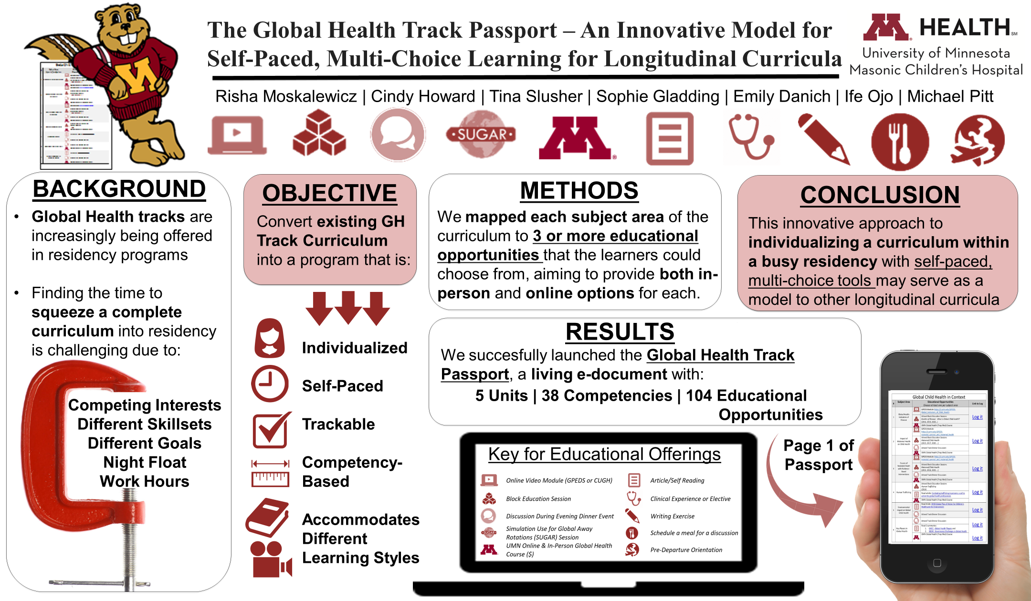

Slide 50

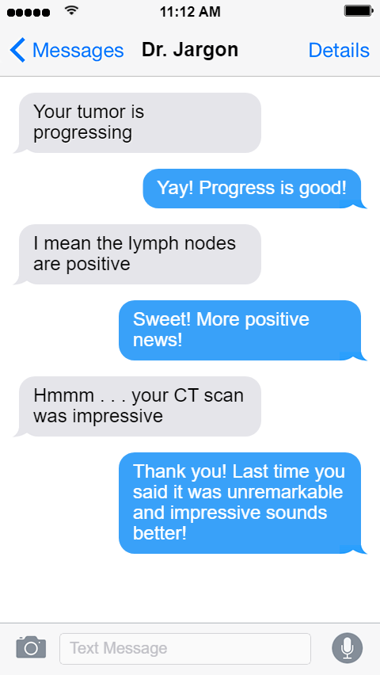
When Negative is Good and Positive is Bad - Patient Understanding of Medicalized English
Rachael Gotlieb | Marissa Hendrickson | Jordan Marmet | Corinne Praska
Victoria Charpentier | Emily Hause | Kate Allen | Scott Lunos | Michael Pitt
OBJECTIVE
METHODS
RESULTS
The use of medical jargon is common during patient encounters. Eliminating medical terminology and acronyms, however, may not address all of the confusion. We wished to evaluate laypeople’s understanding of “Medicalized English” terms that have different meanings in English than they do in medicine.
We surveyed adults without medical training at the 2022 Minnesota State Fair via a voluntary, anonymous, iPad based survey.
Participants responded to multiple choice and short answer questions to demonstrate their understanding of common “Medicalized English” phrases (e.g., positive lymph nodes).
Two researchers scored responses for degree of understanding bringing in a third researcher if needed to address discrepancies.
We compared demographics and survey questions using a t-test for age and Fisher’s exact tests for categorical variables..
217 respondents
63% female
Mean age 42
65% with bachelor’s degree or higher
Phrase | Intended Meaning | Correct
Cancer screening results negative | Do not have cancer (good news) | 96%
Chest X-ray is unremarkable | Chest x-ray is normal (good news) | 80%
Tumor is progressing | Cancer is getting worse (bad news) | 79%
Lymph nodes are positive | Cancer has spread (bad news) | 67%
Neuro exam is grossly in tact | Neuros exam is normal (good news) | 41%
There were bugs in the urine | There is a urinary infection (bad news) | 29%
X-ray was impressive | X-ray had significant findings (bad news) | 21%
You have an occult infection | You have a hidden infection (bad news) | 2%*
More people correctly understood “Your blood test shows me you do not have an infection in your blood” than “Your blood culture was negative” (97% vs 87%, p<0.001).
*More people thought that an occult infection indicated they had a curse (3%) than accurately knew what it meant (2%)
CONCLUSION
Many words and phrases commonly used in medicine have different meanings in everyday usage. We found that several of these terms lead to a mismatch in understanding when used in a medical setting, and that the interpreted meaning may often be the exact opposite of what is intended.

Slide 51
https://ifaketextmessage.com/

Slide 52
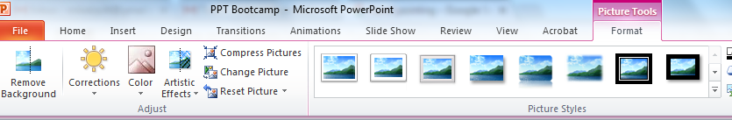


Remove Background Tool

Slide 53



Slide 54

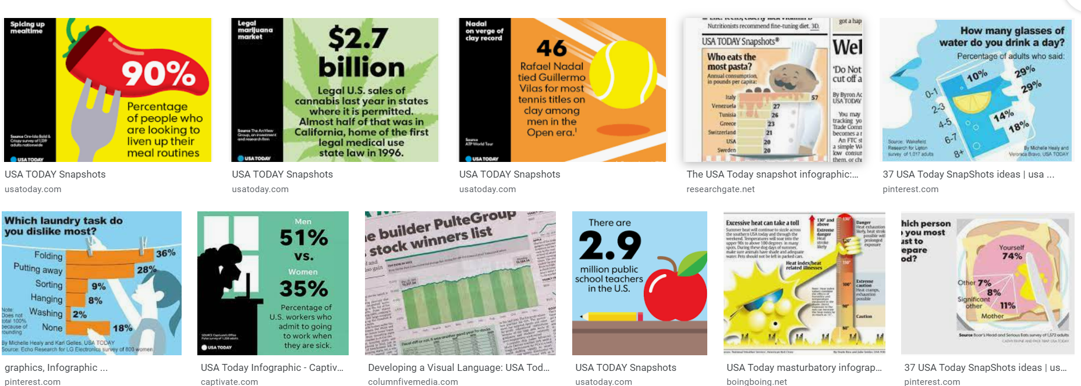
CONCEPT FIVE:
A Picture’s Worth at Least Fifty Words
If a graphic can tell the story, let it!

Slide 55

Search Term: _________ icon or ________ clip art
Also consider nounproject.com

Slide 56




Slide 57
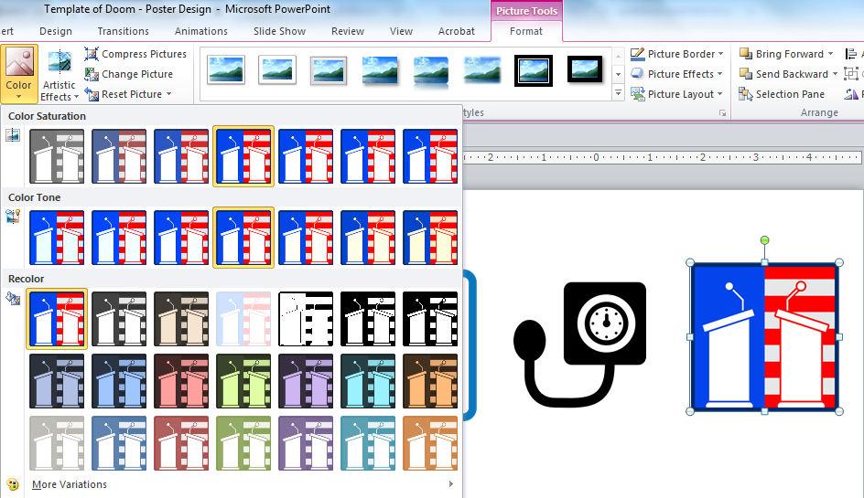

Slide 60


BLAH BLAH BLAH
BLAH BLAH BLAH
BLAH BLAH BLAH

Slide 63
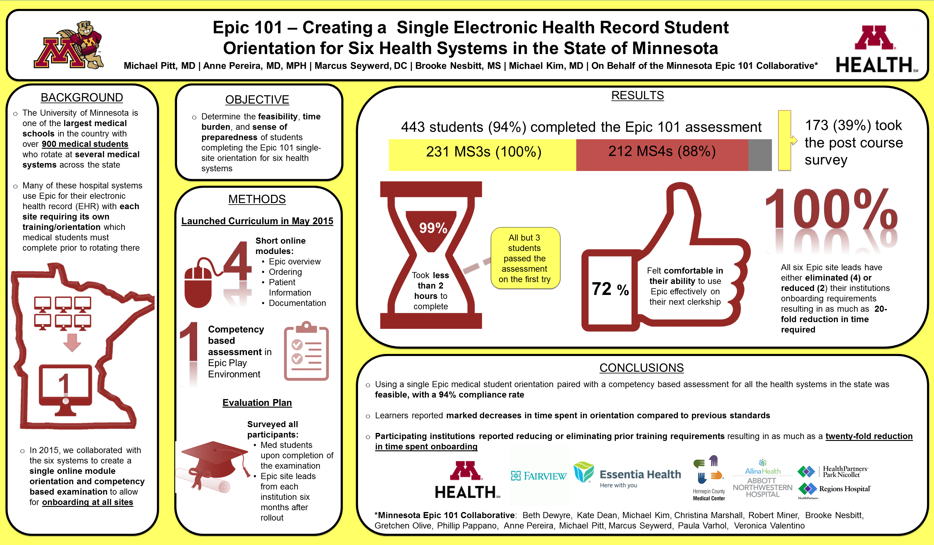

Slide 64
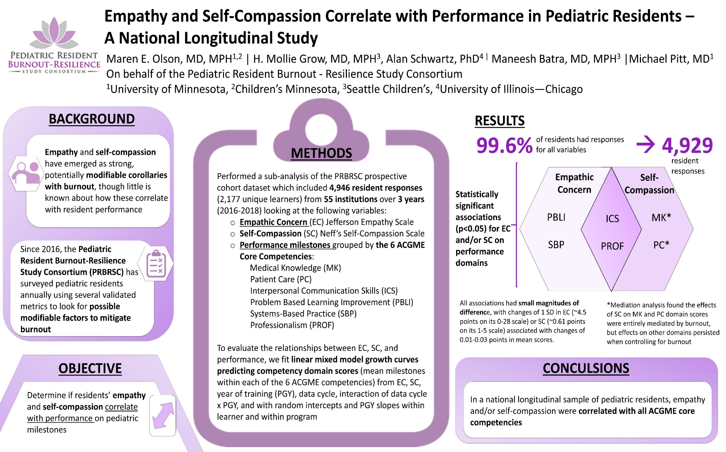

Slide 65


Slide 66
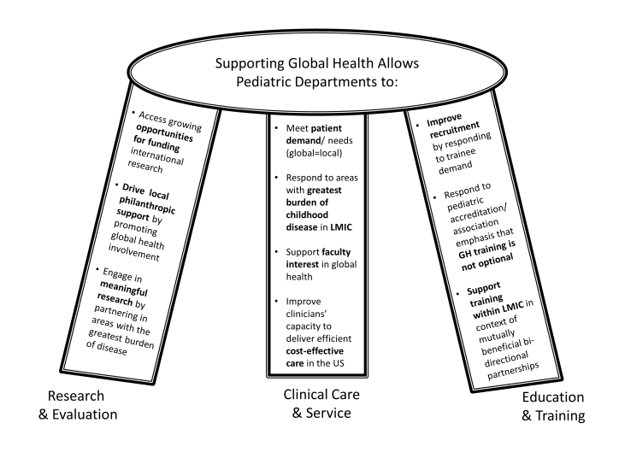
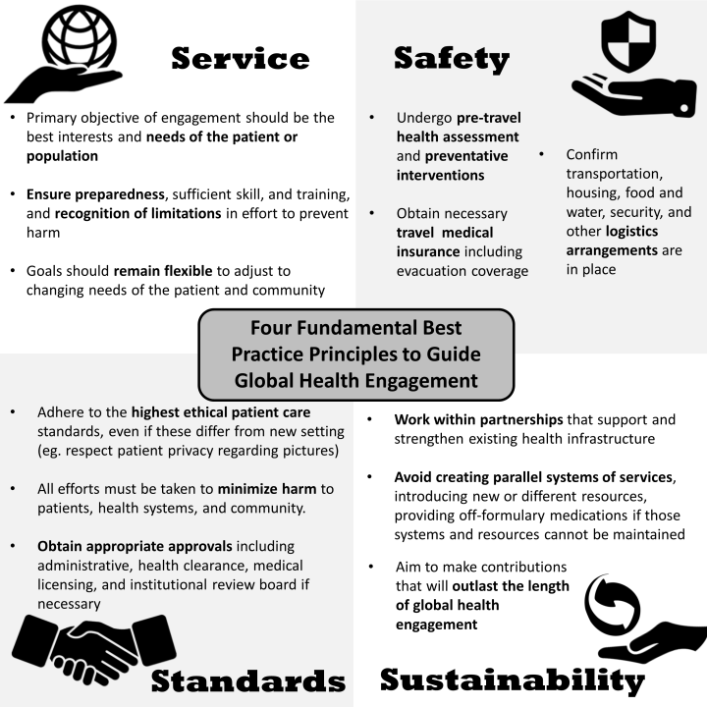
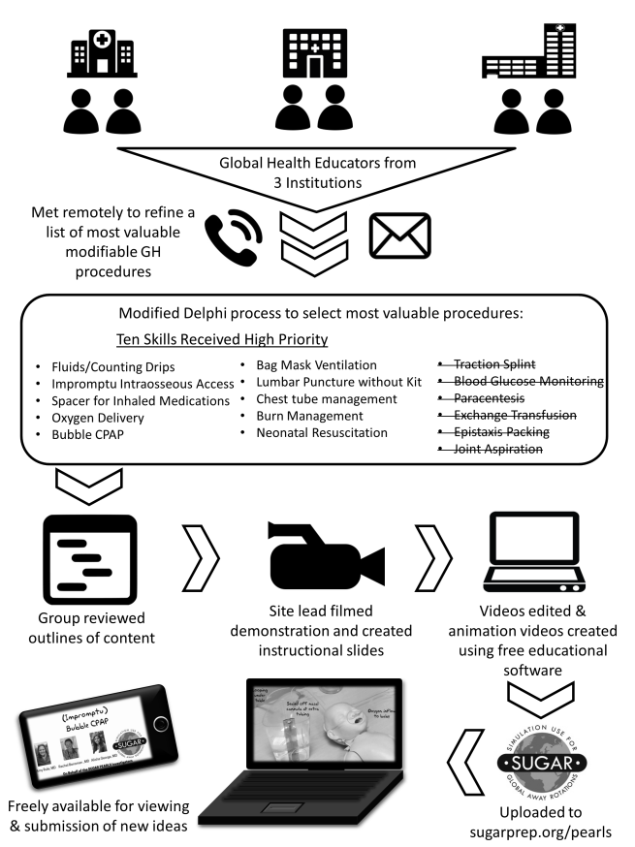
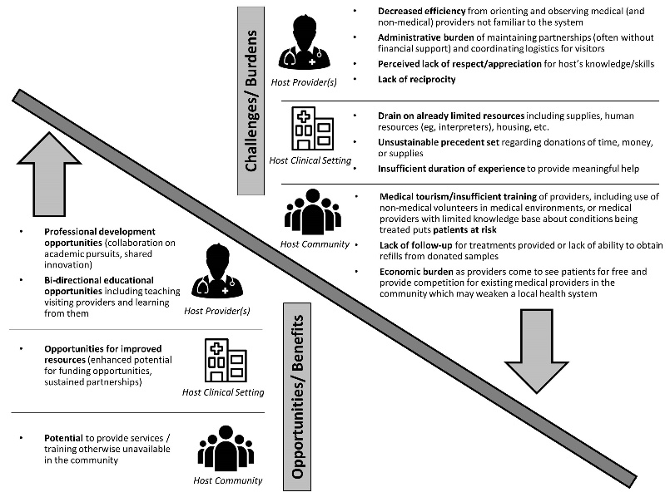
This approach works for manuscript figures too

Slide 67
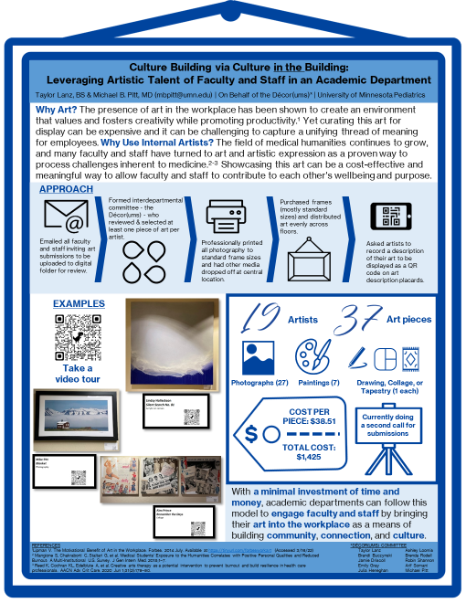
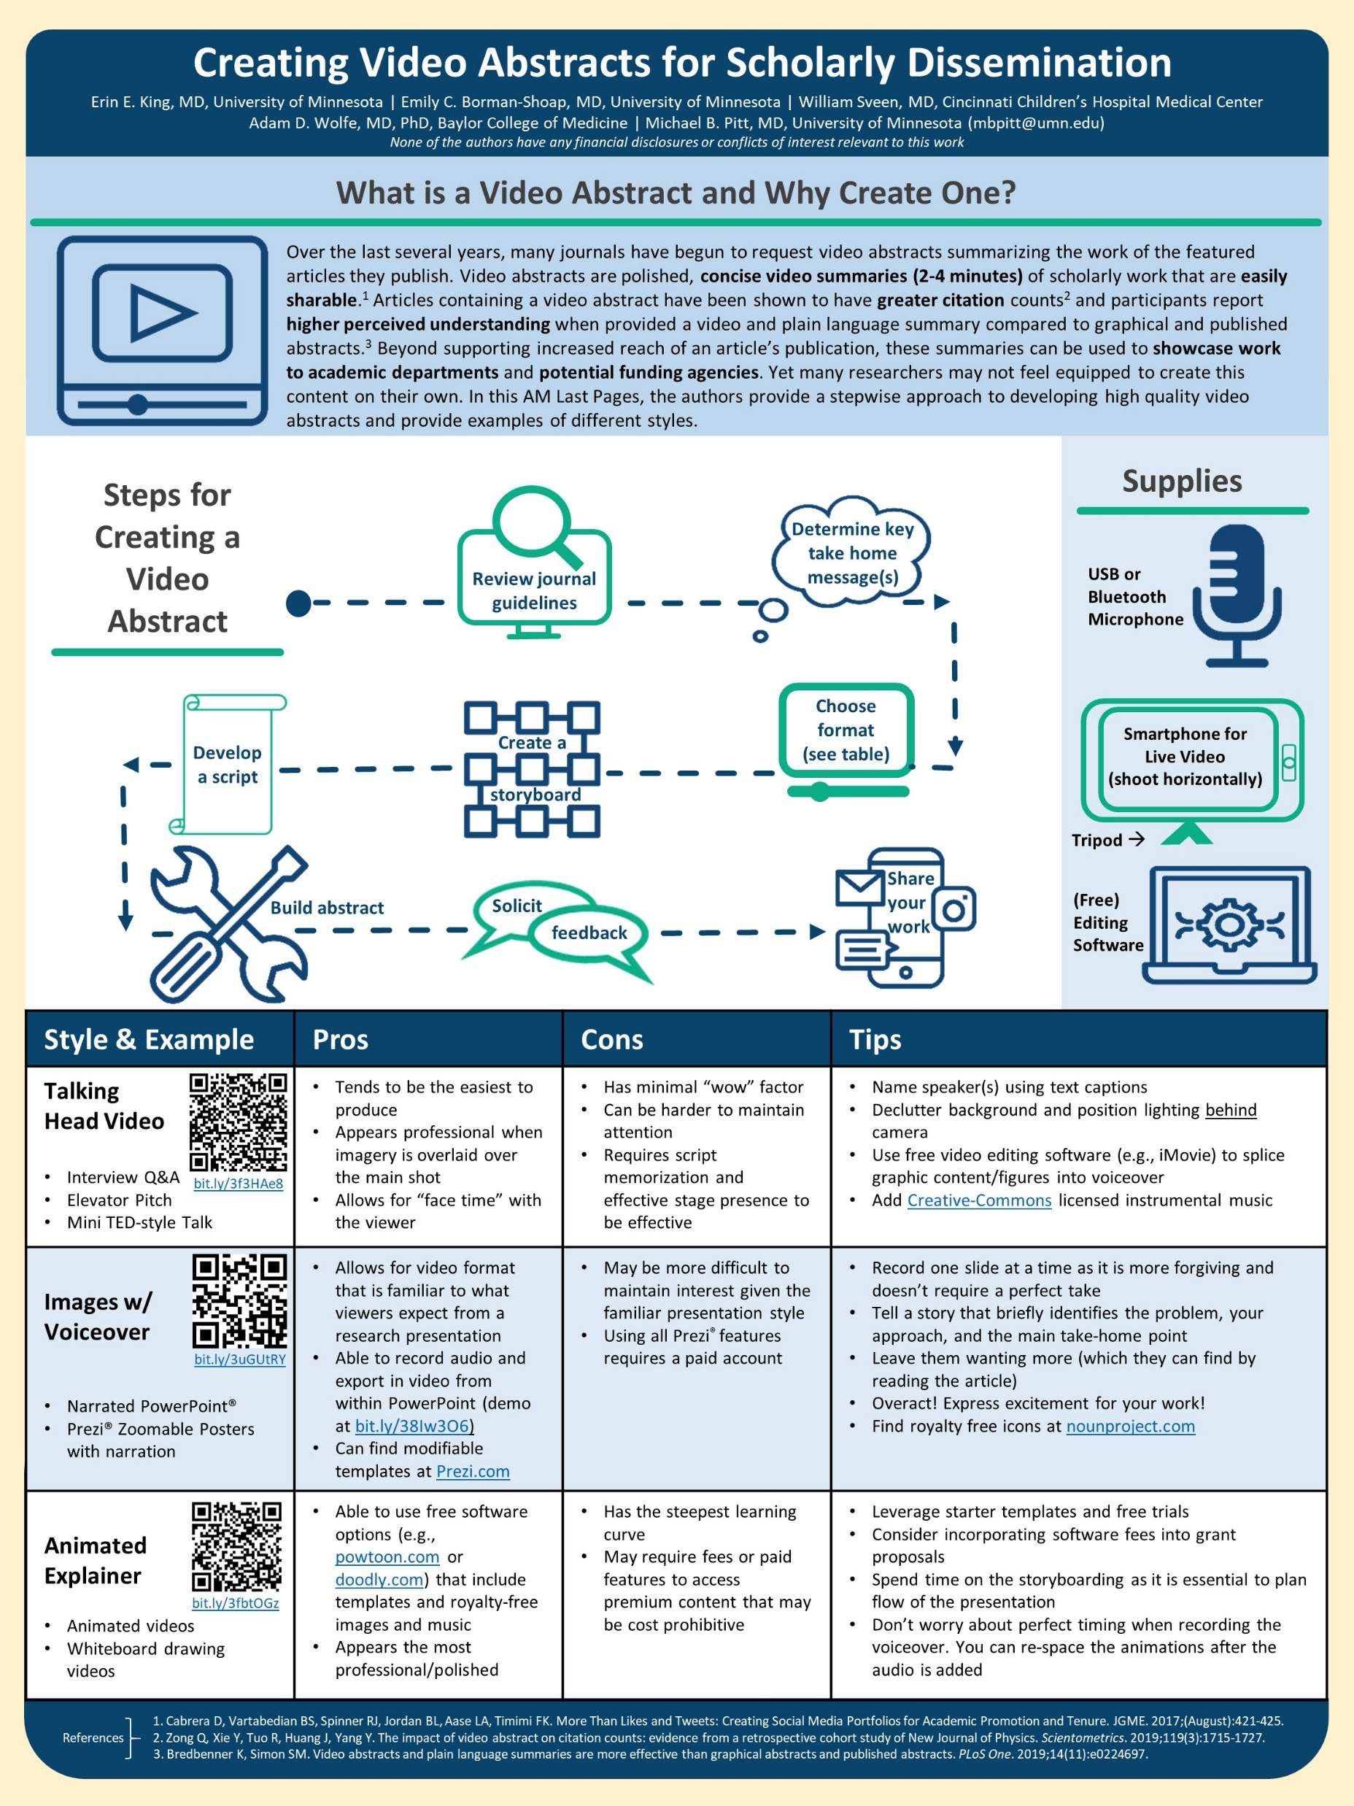

Slide 68


https://www.the-qrcode-generator.com/
Mike Morrison Poster Model

Slide 69

CONCEPT SIX:
Practice a Pitch

Slide 70
Would you like to hear a sixty second overview of the project?

Slide 71

Design still matters – most of the tips apply to slide design as well
Tell. A. (Cool). Story.
For fixed short time presentations – write a script (insert cues “Click”)
Have extra slides prepped for common questions

Slide 72
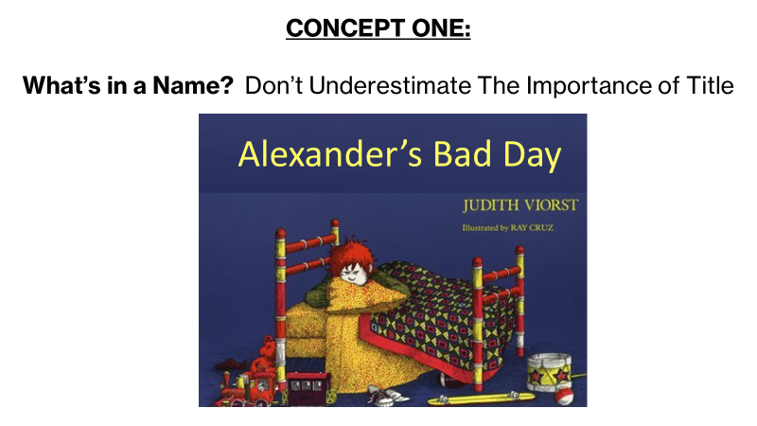
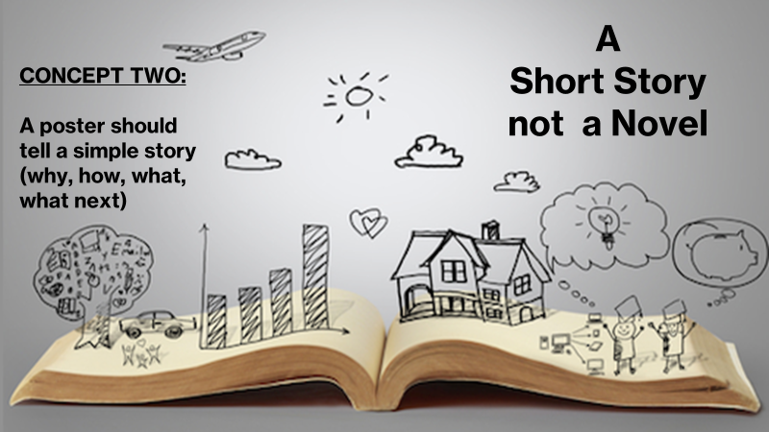
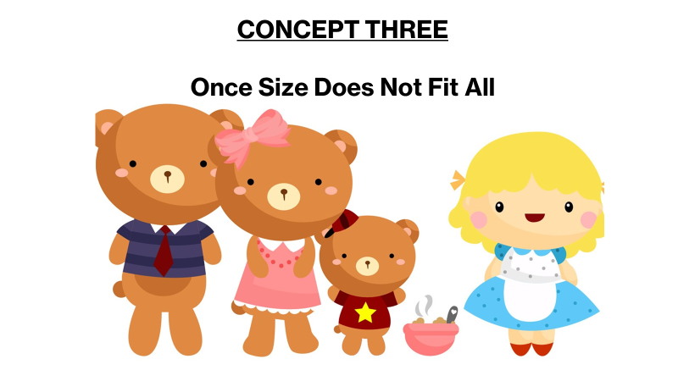


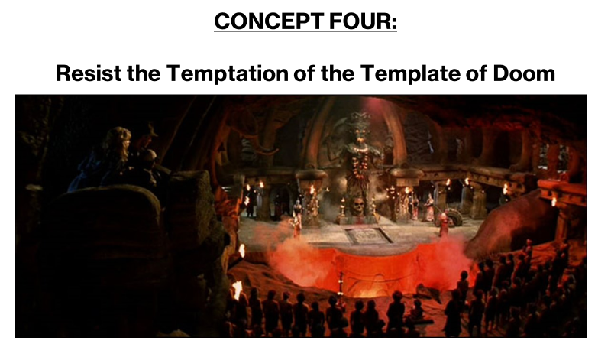
RECAP

Slide 73


