Slide 1
Problem Identification and General Needs Assessment
Targeted Needs Assessment
Goals and Objectives
Educational Strategies
Implementation
Evaluation and Feedback
Kern’s Six Steps

Slide 2
Step 1: Problem ID & General Needs Assessment
Problem ID: What gap are you trying to fill?
What is the current approach? What is the ideal approach? (look within and outside of medicine)
Literature review: PubMed, academic literature from other fields
Curricula review: MedEdPORTAL, APPD ShareWarehouse
Interviews within and outside of the field (learners, experts)
Popular media
How will this impact your stakeholders (patient outcomes, health equity, finances, learner interest…)?

Slide 3
Step 1: Problem ID & General Needs Assessment
Problem: Need for scholarly training
Current approach:
Here: Haphazard, resident driven
General: see above
Ideal approach:
Structured
Resourced
Accountable

Slide 4
Step 2: Targeted Needs Assessment
What has happened HERE in the past?
Needs assessment of current and
past residents
Targeted interviews
Residents
Key institutional stakeholders

Slide 5
Step 3: Goals and Objectives
Broad
Long-term
Refine as your project takes shape
May be more difficult to measure
Unlikely to be accomplished in one sitting

Slide 6
Move toward a more just future, including achieving health equity for all patients

Slide 7
Curricular Goals
Analyze the history of racism & other oppression through a healthcare lens
Examine the way systems of power oppression work in our daily lives
Assess own identity and biases; implement strategies to reduce their impact
Engage others in conversation/action related to social justice
Intervene when witnessing racism and other forms of oppression
Appreciate the benefits to ALL people of working for social justice
Demonstrate the abilities to sit with discomfort and to cause disruption
Plan individual, actionable steps to promoting a more just future

Slide 8
Increase scholarly output among residents
Expose residents to non-clinical aspects of academic medicine
Improve competitiveness of residents for fellowship and/or post-graduate academic positions

Slide 9
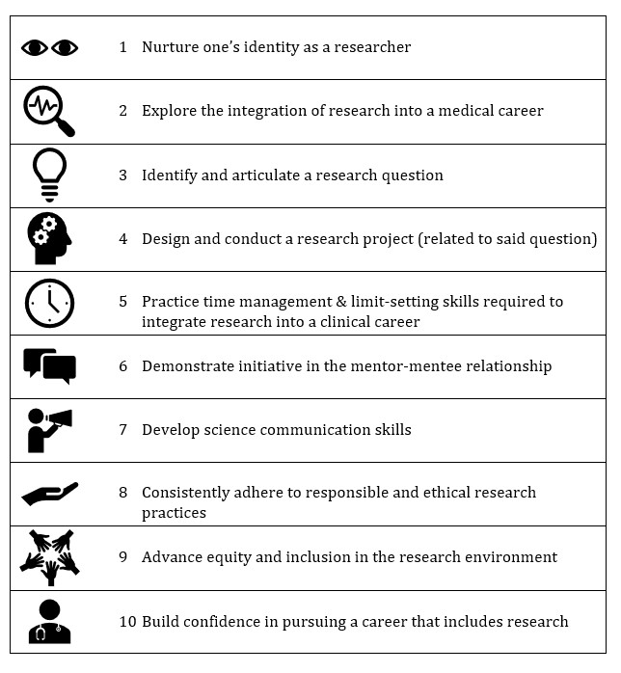

Slide 10
Step 3: Goals and Objectives
Defined, narrow
What you will achieve in one or two sessions
Think SMART (Specific, Measurable, Attainable, Relevant, Time-based)
Start with a stem:
By the end of this session, learners will be able to…
By the end of this workshop, learners will demonstrate improved confidence in…

Slide 11
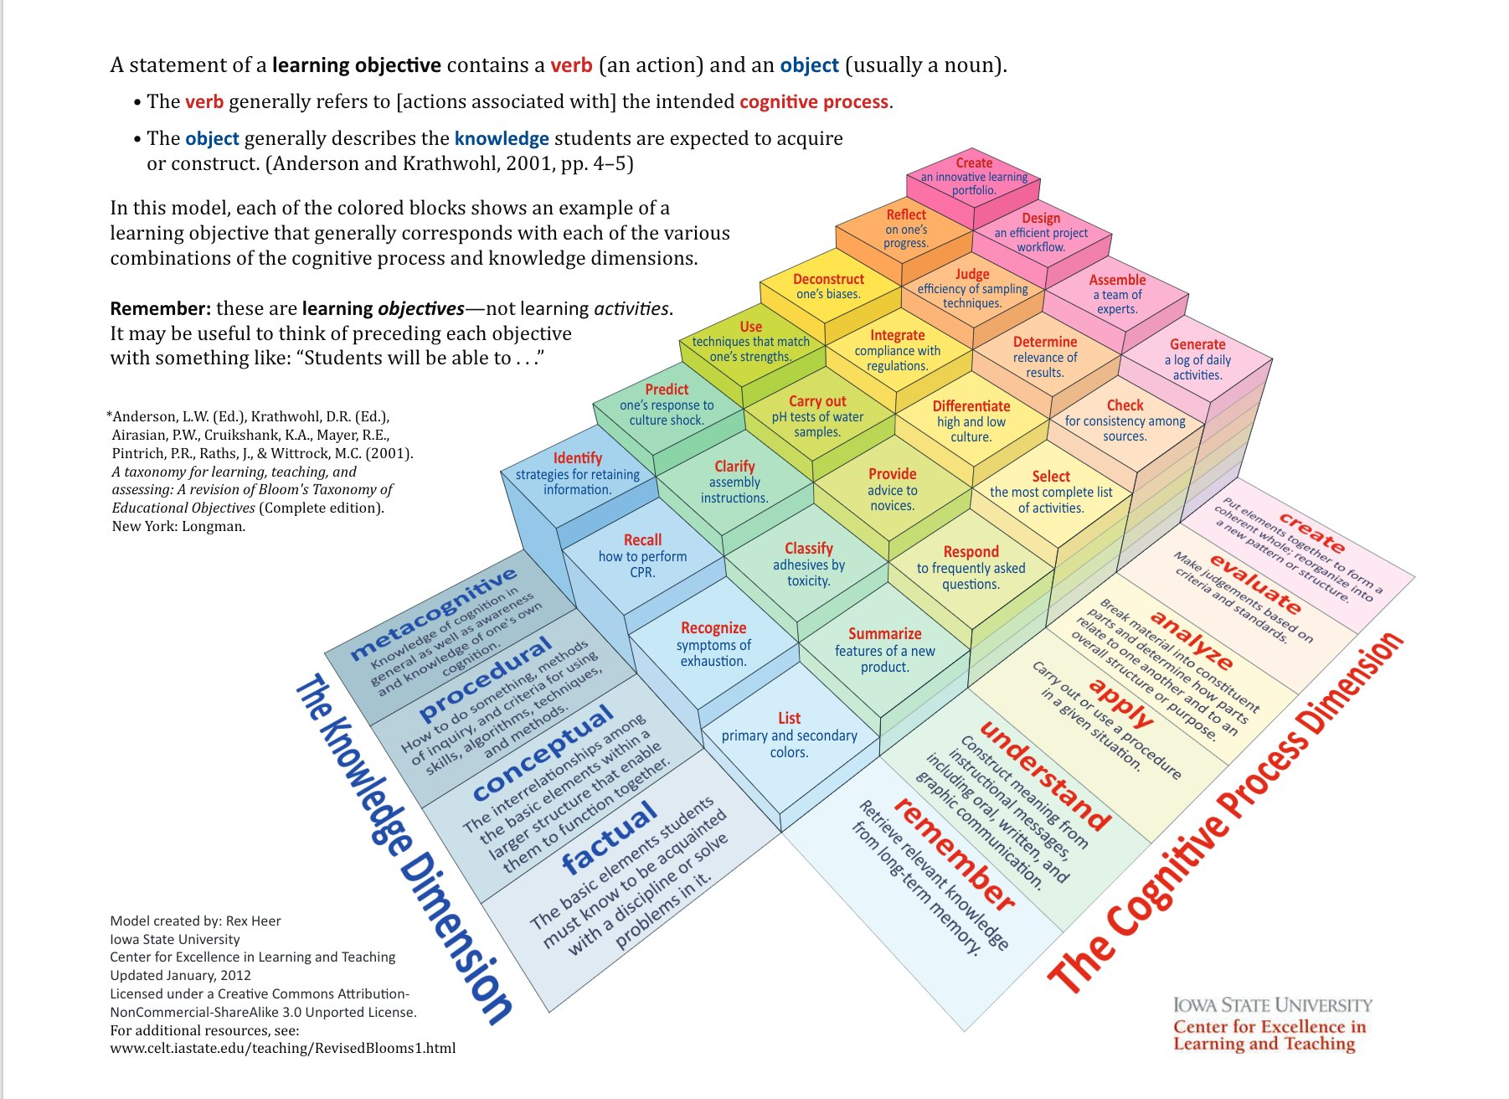
Attitudes
Skills
Knowledge

Slide 12
Share pdf

Slide 14
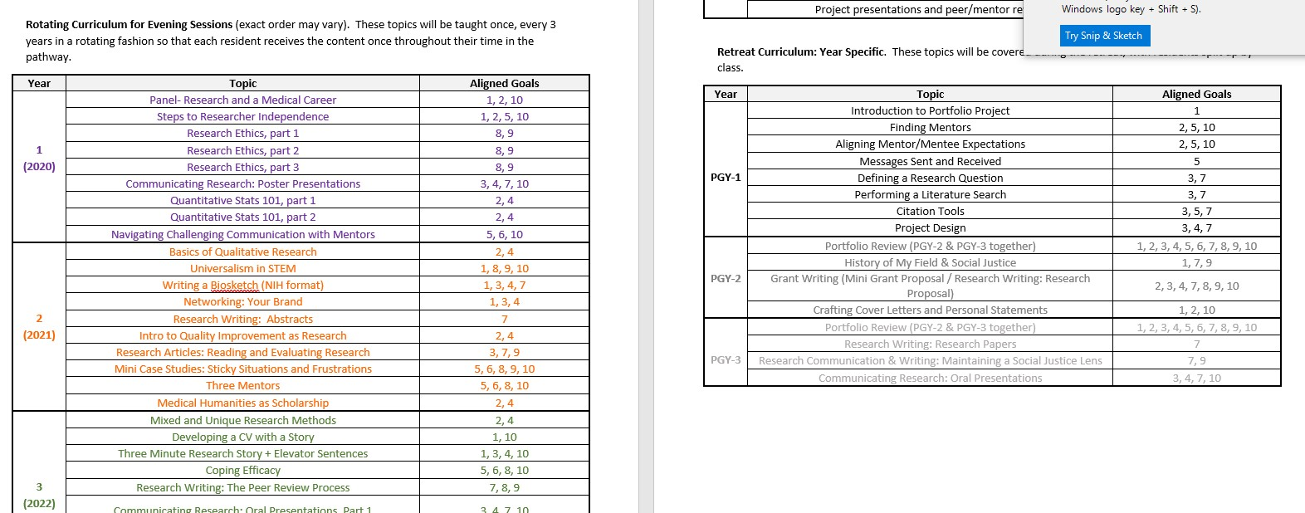

Slide 15
Social Determinants of Health
Define the Social Determinants of Health (SDoH)
Illustrate the five core SDoH, through use of examples
Evaluate the impact of SDoH on individual patients
Identity and Belonging
Explain various definitions of racism
Identify and express the ways their identities were learned and regulated throughout their lives.
Examine the ways messages received about identity might vary depending on what group the learner belongs to. (For example, white students might not remember learning anything about whiteness from television as whiteness is normalized and abundantly represented in television. Students of Color, on the other hand, may have memories of learning negative messages about their racial groups from television.)
Assist in challenging normalized policing of gender, sexuality, race, ability status, and other facets of identity in social groups.

Slide 16
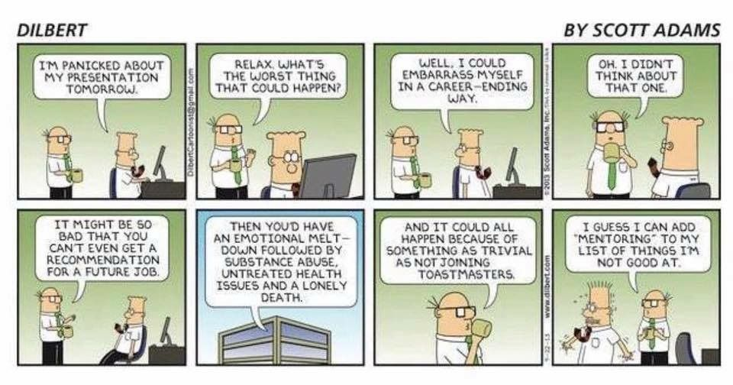
Step 4: Educational Strategies
Uses adult learning principles
Aligned with objectives
Varied

Slide 17
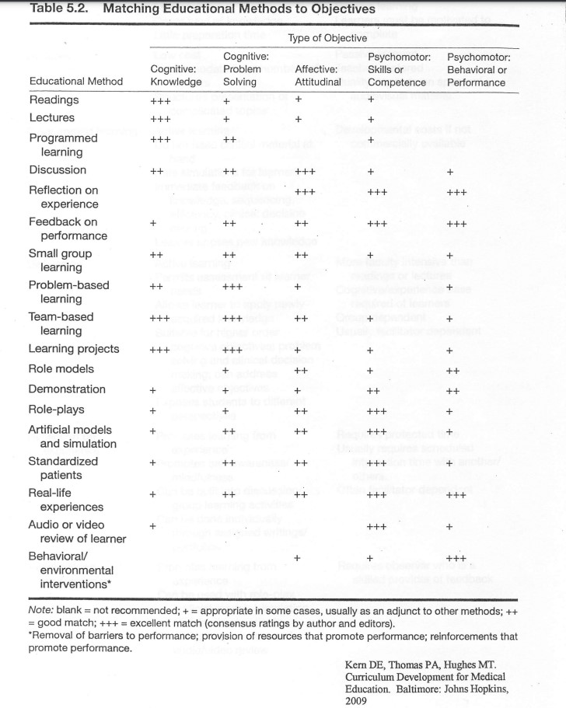
Knowledge
Attitudes
Skills

Slide 18
Step 4: Educational Strategies
Efficient
Effective
Institutional support
Time
Cost
Notes:
Adult learning principles– we know most of these intuitively. Detailed description beyond the scope of this course, but suffice to say you want to consider things we know to be true about adult learners, such as that they are more likely to experience enduring learning if they are actively involved rather than sitting passively; that they are annoyed if we are too basic and don’t value their existing knowledge; you want to build upon what they already know; there is a max cognitive load (eg if there was just an event that is highly taxing to the residents, such as the death of a patient that many residents were just involved with, they may be less able to engage with new, challenging material without a lightening of that load--- adapt! Create a space to process that)
Aligned w/ objectives– we discussed earlier KSA. You want to find something that matches. If your objective is skill based, simply reading about it is not going to be a good strategy. Example: Tyler’s mental health PEARL. Gave knowledge which is requisite to the skill in a lecture, but his actual objective is to improve their skill– so he is doing a simulation to help them practice. Similar for attitudes– Listening to a lecture on health disparity might shift some folks a bit, but creating space for written reflection and discussion that they have to participate in, especially if you ask them to expand upon or defend existing attitudes, is more likely to be effective.
Institutional support, time and cost are somewhat linked. Some teaching methods are more expensive– eg we are doing a sim with standardized patients for the suicide assessment. That is $$. SO you have to make a case for why this is a good use of money, and what benefit this will have over using peer or faculty “actors”. For this topic, mental health, there is a clear call to action from the AAP, ACGME, and others that mental health is a crisis, and great evidence that just reading about this doesn’t really help. Sometimes info from your generalized or targeted needs assessment can help here.

Slide 19
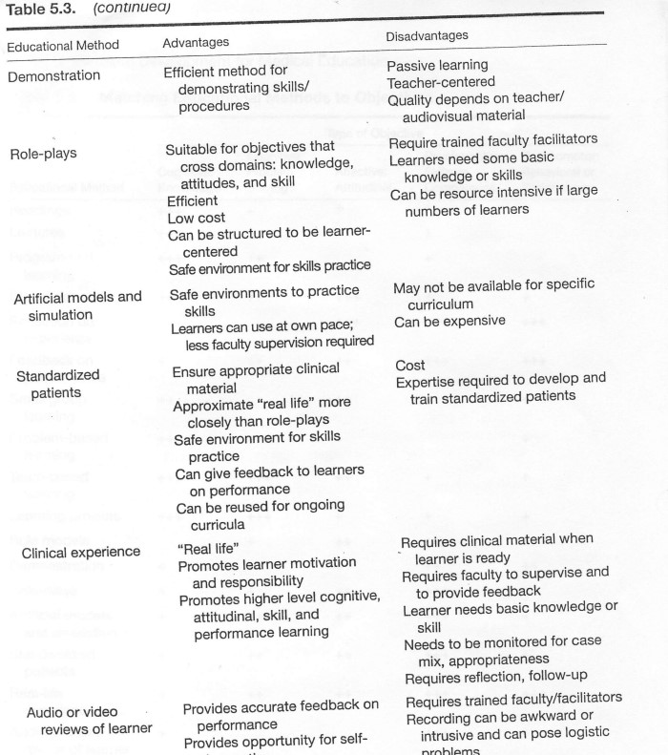
Notes:
Table and discussion of different methods– we will not go through all this.
You can actually google and get a pdf of this table even if you don’t have the book: “kern's summary of advantages and disadvantages educational methods”
https://wiki.uiowa.edu/download/attachments/109784361/Kern%20et%20al%20Ed%20Methods%20Review.pdf?version=1&modificationDate=1384870614637&api=v2

Slide 20
Step 5: Implementation
Gather your resources
Personnel
Time
Facilities
Funding
Ensure support
Administrative mechanisms for ongoing use
Pilot → Full implementation

Slide 21
Step 6: Evaluation and Feedback
Purpose
Assess learning
Curricular refinement
Learner promotion
Grades, learner differentiation
Dissemination
Research
Time, resources, cost
Existing tools

Slide 22
Evaluation
Attitudes toward Social Justice
Outcome Expectations
Perceived Behavioral Control
Behavioral Intentions
Subjective Norms

Slide 23
Portfolios
# of publications
Post-retreat evaluations
Ongoing Recruitment

Slide 24
Putting it all together

Slide 25
Problem Identification and General Needs Assessment
Targeted Needs Assessment
Goals and Objectives
Educational Strategies
Implementation
Evaluation and Feedback

