Slide 1
What is Type 1 Diabetes?

Slide 2
Session Objectives
Define Diabetes
Provide a brief overview of the way insulin is secreted and used in people without diabetes
Discuss the cause of Type 1 Diabetes
Review the symptoms and basic information about treatment of Type 1 Diabetes

Slide 3
What is diabetes?
When a person has diabetes there is too much sugar (glucose) in the blood stream
This happens because of a problem with the hormone INSULIN
There are 2 different types of diabetes. Today we will focus on Type 1.
Notes:
The word "diabetes" is from the Greek word meaning "a siphon" because people with diabetes "passed water like a siphon.".

Slide 4
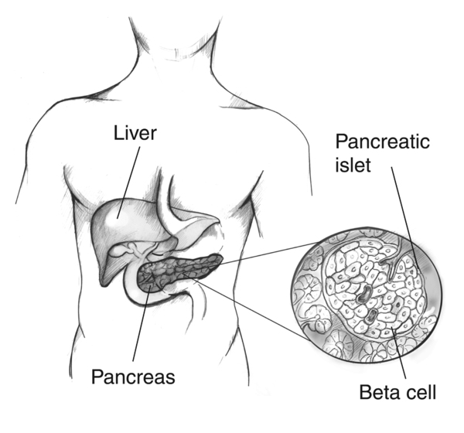
Normal Physiology (how the body works in someone WITHOUT diabetes)
INSULIN unlocks the doors to our cells and lets glucose get in so that it can provide ENERGY
We need ENERGY all of the time!
The body knows just how much insulin to provide and when
Notes:
Insulin is a hormone produced by the beta cells in our pancreas

Slide 5
Normal Physiology (how the body works in someone WITHOUT diabetes)
There are 2 places that sugar comes from
Liver
Stores energy for use when we are not eating
Eating
We take in sugar (mostly in the form of carbohydrates), then it is digested in our stomach and absorbed into our blood stream

Slide 6
Normal Physiology (how the body works in someone WITHOUT diabetes)
Sugar (Glucose)
Cell
Insulin
Insulin
ENERGY
Insulin
ENERGY
ENERGY
Insulin

Slide 7
Type 1 Diabetes
In someone with Type 1 Diabetes the pancreas is no longer able to produce insulin
Without insulin, the body cannot get sugar (glucose) into the cells for energy
Builds up in the blood stream, leading to high blood sugar

Slide 8
Type 1 Diabetes
Sugar (Glucose)
Cell

Slide 9
Type 1 Diabetes
The body has plenty of sugar, but without insulin it cannot be used for energy
The child may feel HUNGRY
The body looks for other ways to make energy and begins to burn fat
This can be dangerous because it leads to a build up of acid in the blood

Slide 10
What Causes Type 1 Diabetes?
Type 1 Diabetes is an AUTOIMMUNE disorder. This means that the body’s own cells attack and destroy the beta cells in the pancreas that make insulin
There is no single cause for diabetes
A combination of genetics, environment, and viral illness are likely responsible
We do know one thing for sure: There is nothing that a child or their family did to CAUSE Type 1 Diabetes.
And there is nothing that can be done to prevent Type 1 Diabetes at this time
Notes:
Pancreas is still functional – just not insulin

Slide 11
How do we know if someone has Type 1 Diabetes?
The symptoms of diabetes include:
Eating a lot (polyphagia)
Drinking a lot (polydipsia)
Peeing a lot (Polyuria)
High sugar (glucose) levels or evidence of high glucose levels in the blood
High levels of ketones in the urine
Markers in the blood that indicate autoimmune destruction of the beta cells

Slide 12
How is Type 1 Diabetes Treated?
Someone with Type 1 Diabetes will need to take injections of insulin under the skin every day
There are no oral medications that can make insulin in the body for someone with Type 1 Diabetes
We try to give insulin by injection to mimic the way a pancreas would give insulin
Insulin can cause a low blood sugar, so patients also carry Glucagon, a rescue medication to use if their blood sugar gets dangerously low

Slide 13
Additional Resources
AFCH Pediatric Diabetes Website
Growing Up Healthy Blog: Type 1 101
Beyond Type 1
JDRF
ADA Safe at School
Training Videos
Pink Panther Book (requires purchase)

